Slide 1

Delirium care: tackling real world challenges in detection, treatment and prevention
Alasdair MacLullich
Professor of Geriatric Medicine, University of Edinburgh
Consultant in Medicine of the Elderly, Royal Infirmary of Edinburgh
a_maclullich

Slide 2
Outline
What is delirium?
Delirium versus dementia: telling them apart
Detection
Treatment
Prevention
Improving the whole system of care
Conclusions and resources

Slide 3
What is delirium?
Notes:
3

Slide 4
Mrs PT, an 85 year old lady, is living at home independently. She has some concerns about her memory but generally manages with day to day activities.
Unfortunately Mrs PT has a fall at home and finds that she can’t get up. She calls an ambulance. In the hospital an X-ray shows a broken hip.
Her son comes to visit that evening and finds her to be very confused, which is different from her normal self. She is upset and agitated, and can’t concentrate on a normal conversation.
Mrs PT does not believe that she has a broken hip, and she keeps trying to get out of bed so that she can return home. She tells her son that she has been wrongfully arrested and has been locked up in a police station. Mrs PT asks her son to help her escape.
The son and the staff note that Mrs PT is frightened and distressed.
Notes:
Delirium is very common, and it is likely that most of the audience have come across it – certainly those working in healthcare, and also I think many people have witnessed or even experienced delirium in their personal lives.
To help illustrate this I have summarised a real cases from my own practice here in this hospital
The first involves a lady …

Slide 5
Working definition of delirium
Rapid (hours, days) deterioration in mental functioning, triggered by:
acute illness, injury (e.g. hip fracture), side effects of medication, surgery, etc.

Slide 6
“A change in the patient”

Slide 7
Acute confusional state
Worsening confusion
ICU psychosis
Not themselves
Altered mental status
More sleepy
Many terms for delirium: makes consistent care difficult
Acute on chronic confusion
Acceleration of dementia
Acute brain failure
More confused
Acute encephalopathy
More agitated
Best to use delirium

Slide 8
How common is delirium?
~15% of hospitalised patients
~20% of older ED patients
~50% in palliative care settings
? 5% in care homes (uncertain)
? 1-2% in older people living at home (uncertain)

Slide 9
What are the background risk factors for delirium?
Older age
Dementia
Frailty
Sensory impairment
Chronic illness
Previous episodes of delirium

Slide 10
Risk of future dementia
Length of hospital stay
Post-traumatic stress symptoms
Mortality
New institutionalisation
Consequences of delirium
Dehydration
Readmission rates
Aspiration pneumonia
Pressure sores
Severe distress
Poor nutrition
Falls
Notes:
10

Slide 11
How long does delirium last?
The median duration is 3-5 days
Some resolves very quickly if one major cause that is treated promptly
Around 20% of patients have prolonged symptoms
Recovery may be partial or in some cases severe symptoms can persist
At the end of life delirium commonly arises and is often irreversible

Slide 12
Why should delirium be detected?
Notes:
12

Slide 13
10 reasons to detect delirium www.deliriumwords.com
Can be presenting feature of life-threatening illness
Ongoing rehabilitation - modified
Prompts assessment for delirium-associated risks such as falls, immobility, dehydration
Prompts search for acute triggers
Communicate the diagnosis to patients and carers
Access to standard delirium treatment pathways
May be a sign of undiagnosed dementia
Prognostic information
To identify & treat distress
Accurate coding: important in future care

Slide 14
Delirium versus dementia
Notes:
14

Slide 15
Delirium versus dementia
Delirium
Rapid onset (hours, days)
Inattention (hard to focus)
Often resolves in few days
Fluctuates more than dementia
Drowsiness / hyperactivity common
New paranoia & hallucinations in ~30%
Dementia
Slow onset (months, years)
Many do not have significant inattention
Mostly irreversible
Drowsiness uncommon (late stages only)
Notes:
15

Slide 16
Clinical care
Notes:
16

Slide 17
Delirium care: 3 pillars
Detect all delirium
Goals in delirium care
Treatment of detected delirium
Reduce the risk of delirium (prevention)

Slide 18
Detection
Notes:
18

Slide 19
How can delirium present?
Persistent sleepiness
Strange new ideas, e.g. being poisoned
Hyperactivity
Mixed-up speech
Hallucinations
Altered sleep-wake cycle
Irritability/marked change in mood
Lethargic/quiet/saying little

Slide 20

Scenario A: newly-unwell patient
E.g. 86 year old man in A&E with pneumonia
Question: how can you tell if this man has delirium?
Notes:
20

Slide 21

Scenario B: delirium arising in inpatients or residents
E.g. 90 year old woman resident in a care home
History of dementia and stroke
High risk of delirium
Question: how can we monitor for new-onset delirium in this lady?
Notes:
21

Slide 22
How can we get to a diagnosis?
2 main ways:
[A] Assess for delirium in all unwell older or other high-risk patients
Any acute illness
Do the 4AT as a standard part of the acute assessment
[B] Regular monitoring for delirium in care home residents/inpatients
‘Think Delirium’ – be vigilant for drowsiness, distress, or any signs of change in behaviour
Some use tools like the Single Question in Delirium (SQiD)
If any suspicion, do a 4AT
Notes:
22

Slide 23
Assessment in acutely unwell patients
Acutely unwell, older (>65) or other risk factors
4AT
Monitoring
NO
Care home residents/older inpatients/others with high baseline risk
MONITOR daily for signs of delirium
Signs of delirium?
4AT
YES
Notes:
23

Slide 24
Alertness
AMT4
Attention
4AT
Acute change / fluctuation

Slide 25
4AT (www.the4AT.com)
3 bedside items (~1 min total)
Alertness (drowsy or hyperactive)
AMT4 (age, date of birth, place, current year)
Attention (months backwards)
1 onset item (usually <1 min)
Acute onset/fluctuation
‘a change in the patient’
Notes:
25

Slide 26
Score range 0-12
4/12 or more suggests delirium
1-3/12 suggests cognitive impairment
0 suggests no significant cognitive impairment
Notes:
26

Slide 27
Single Question in Delirium (SQiD)
“Is your patient more confused or drowsy than normal?”
SQiD e.g. daily is useful
But main point is that rapid CHANGE in mental function often = delirium
Notes:
27

Slide 28
How can we assess for recovery?
Notes:
28

Slide 29
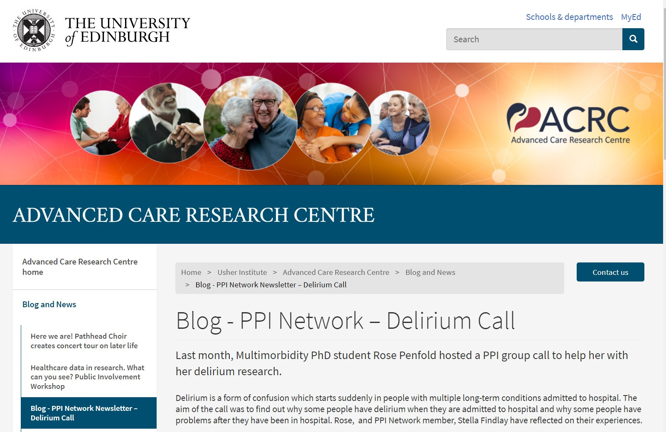
Delirium recovery = a patient priority
‘Through our discussion, I gained a deep appreciation of the importance of “returning to [a new] normal” following an episode of delirium.
This normality encompassed returning home again following the hospital admission, regaining independence in day-to-day living, and being able to think with the same clarity as before the hospital admission.’
- Dr Rose Penfold

Slide 30
What is delirium recovery?
Essentially delirium  no delirium
Depends on (a) Dx of delirium, and (b) process to check if recovered
What is known about assessment of recovery?

Slide 31
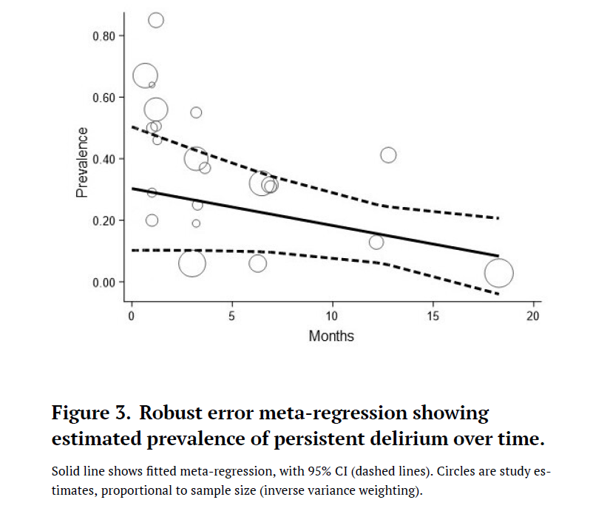
Persistent delirium
Whitby et al, Delirium 2022

Slide 32
N=120 study of delirium recovery
Prospective observational diagnostic accuracy study
N=120 hospitalized patients ≥70 years old with delirium
Assessed with DSM-5 ref standard & 4AT (independent raters)
Assessed 2-4 occasions over ≤9 days
Analysis: sensitivity & specificity at repeated assessments

Slide 33
4AT in assessing delirium recovery
2-4 assessments over ≤9 days (mean = 5 days, range 2-9 days)
2nd assessment: sensitivity 95% specificity 67%*¹
3rd assessment: sensitivity 96% specificity 89%*²
4th assessment: sensitivity 94% specificity 100%
*Lower limit of 95% confidence intervals all >0.87, except ¹(0.13-1), & ²(0.71-1)

Slide 34
Delirium recovery: practice points
First step is detection, using the word ‘delirium’
Then include plan for reassessments
Monitor specific features, e.g.
  ‘patient still drowsy’ / ‘patient now more awake’
  ‘patient still distressed & hallucinating’ / ‘less distressed. Denies hallucinations’
Document resolution or persistence in transfers of care
4AT provides a useful tool to assist in tracking recovery

Slide 35
Treatment
Notes:
35

Slide 36
Identify & treat causes
Optimise conditions for brain recovery
Initial check for acute, life-threatening causes
Detect & treat distress
Consider dementia
Consider follow-up
Delirium 8
Prevent complications
Rehabilitation during delirium
Communicate with patient & carers
Monitor
for recovery

Slide 37
Identify & treat causes
“Treat the cause” ?
  Single cause of delirium found in < 50% of cases
  Multiple possible pathways to delirium
   TREAT THE CAUSES
Notes:
37

Slide 38
Common causes of delirium
Infection (UTI, chest, skin, cholecystitis, etc.)
Dehydration / acute kidney injury
Constipation
Drug changes (starting or stopping)
Injuries
Psychological stress

Slide 39
Help the brain recover
Fluids
Food
BP
Engagement
Mobilisation

Slide 40
Identify & treat causes
Optimise conditions for brain recovery
Initial check for acute, life-threatening causes
Detect & treat distress
Consider dementia
Consider follow-up
Delirium 8
Prevent complications
Rehabilitation during delirium
Communicate with patient & carers
Monitor
for recovery

Slide 41
Detect & treat distress
    Find out why:
    Urinary retention (very common)
    Pain (very common)
    Constipation
    Dehydration
    Fear, anxiety
    Psychosis
    Then address remediable causes
    Also specifically treat distress:
    Reassurance
    Family involvement
    One-to-one nursing
    Drugs only if necessary …
Notes:
41

Slide 42
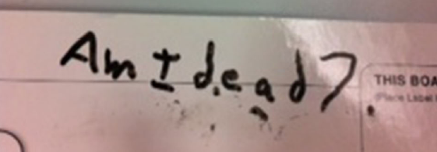

Slide 43
Speaking therapeutically to a person with delirium
    Multiple accounts from people with delirium:
    Wide range in the way staff speak to them
    Unhelpful: silence, no info, speaking about them with others, no introduction, doing things like taking blood without explaining
    Helpful: friendly, warm, encouraging, reassuring, introducing self, providing clear explanations, explaining what is going on
    “You can’t be too orientated.”
    “That porter was so kind that if I won the lottery I would give him my winnings.”
Notes:
43

Slide 44
What is the role of drugs in delirium treatment?
No evidence of overall delirium treatment effect, so …
No prescription just for delirium diagnosis
If severe distress/danger - no evidence, but expert consensus:
Consider single doses or 1-2 days of risperidone, haloperidol, etc. Low doses!
Benzos 2nd line or alcohol etc., if antipsychotics contraindicated
Notes:
44

Slide 45
Identify & treat causes
Optimise conditions for brain recovery
Initial check for acute, life-threatening causes
Detect & treat distress
Consider dementia
Consider follow-up
Delirium 8
Prevent complications
Rehabilitation during delirium
Communicate with patient & carers
Monitor
for recovery

Slide 46

Communicate with patients & carers
Notes:
46

Slide 47
Identify & treat causes
Optimise conditions for brain recovery
Initial check for acute, life-threatening causes
Detect & treat distress
Consider dementia
Consider follow-up
Delirium 8
Prevent complications
Rehabilitation during delirium
Communicate with patient & carers
Monitor
for recovery

Slide 48
Delirium at the end of life
Delirium very common in last few days or weeks of life
Diagnosis is of value: reversal / reduced severity is sometimes possible
Worth considering treatable causes
Sometimes delirium is irreversible
Focus then is on symptoms: non-drug & drug treatments
Antipsychotics/benzos/opioids
Notes:
48

Slide 49
Prevention
Notes:
49

Slide 50
Delirium prevention
HELP (1999): 6 domains
Reality orientation, sleep, mobilisation, vision, hearing, hydration.
HELP (2013): 9 domains
Added (because of NICE guidelines): Hypoxia, infection, pain.
NB HELP requires volunteers: challenging to implement.
SIGN Guidelines (2019)
Orientation
Vision
Hearing
Sleep
Early mobilisation
Pain control
Postoperative complications
Hydration
Nutrition
Regulation of bladder and bowel function
Hypoxia
Medication review
Domains in other studies:
Family involvement, cognitive stimulation.
Systematic review & meta-analysis: Ludolph et al. 2020
8 RCTs; 3 HELP-based. Significant effect on risk of delirium; not on duration, falls, LOS, mortality.
NB no difference between HELP & non-HELP – i.e. volunteers not required for all prevention protocols
Notes:
50

Slide 51
Improving the whole system of care
Notes:
51

Slide 52

Multiple ingredients

Slide 53
Education
Basic knowledge in practitioners
Skills
Effective processes
Implementing
guidelines: ingredients
Attitudes &
culture
Institutional knowledge
+ support
Quality improvement
Government support
Audit (measurement)
Policy  Standards

Slide 54
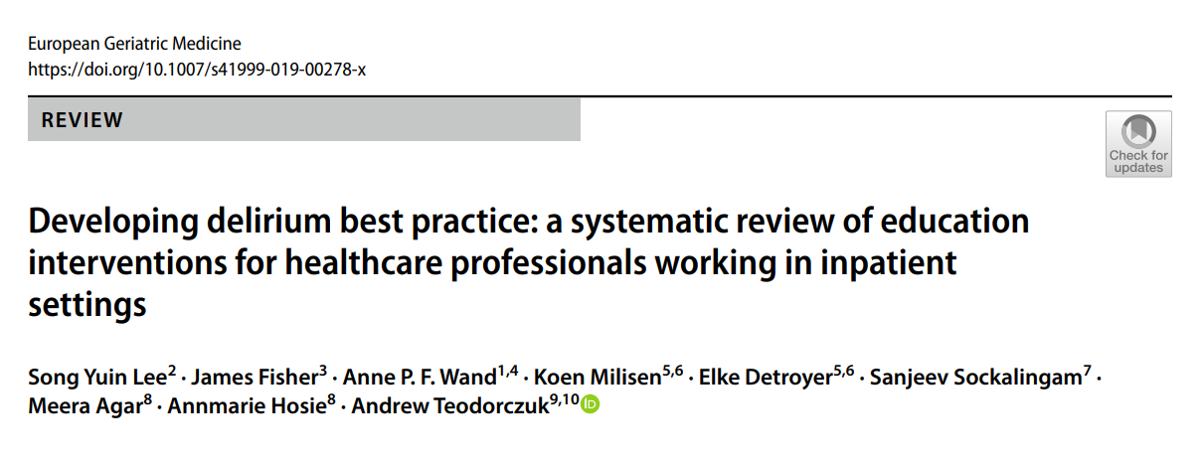
Education improves delirium care: systematic review
N=42 studies
“Taken together, these findings would support the hypothesis that education can improve staff learning and patient healthcare outcomes in research settings.”

Slide 55
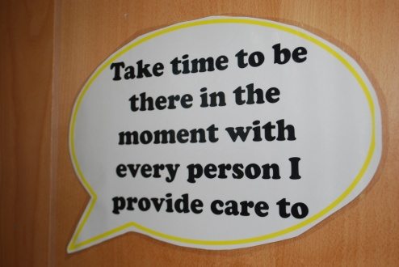



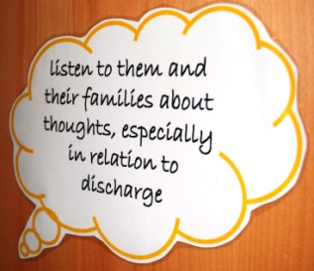
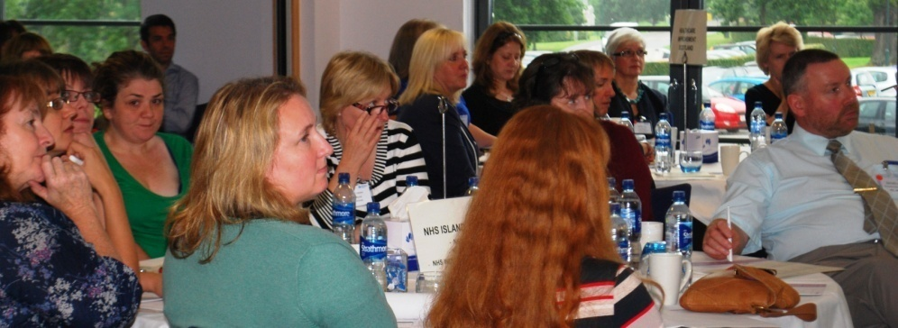

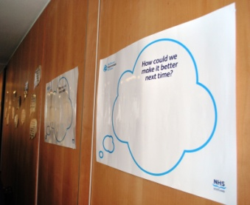
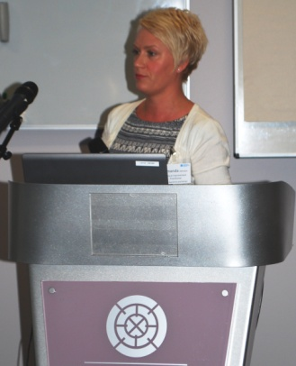

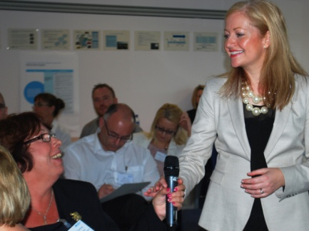
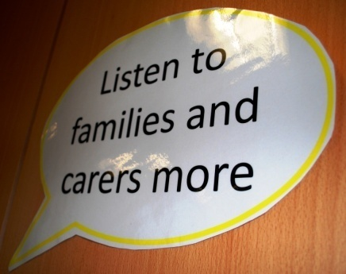
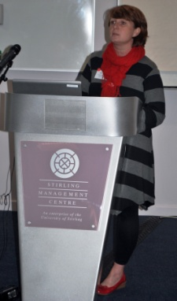
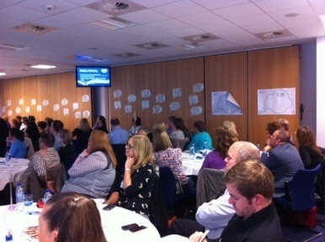
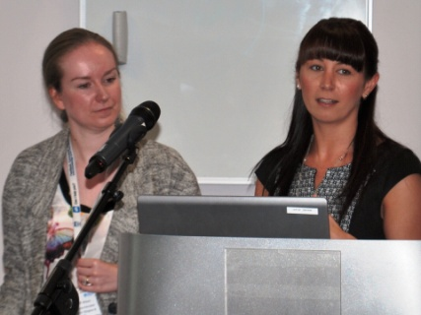

Improvement and engagement events

Slide 56
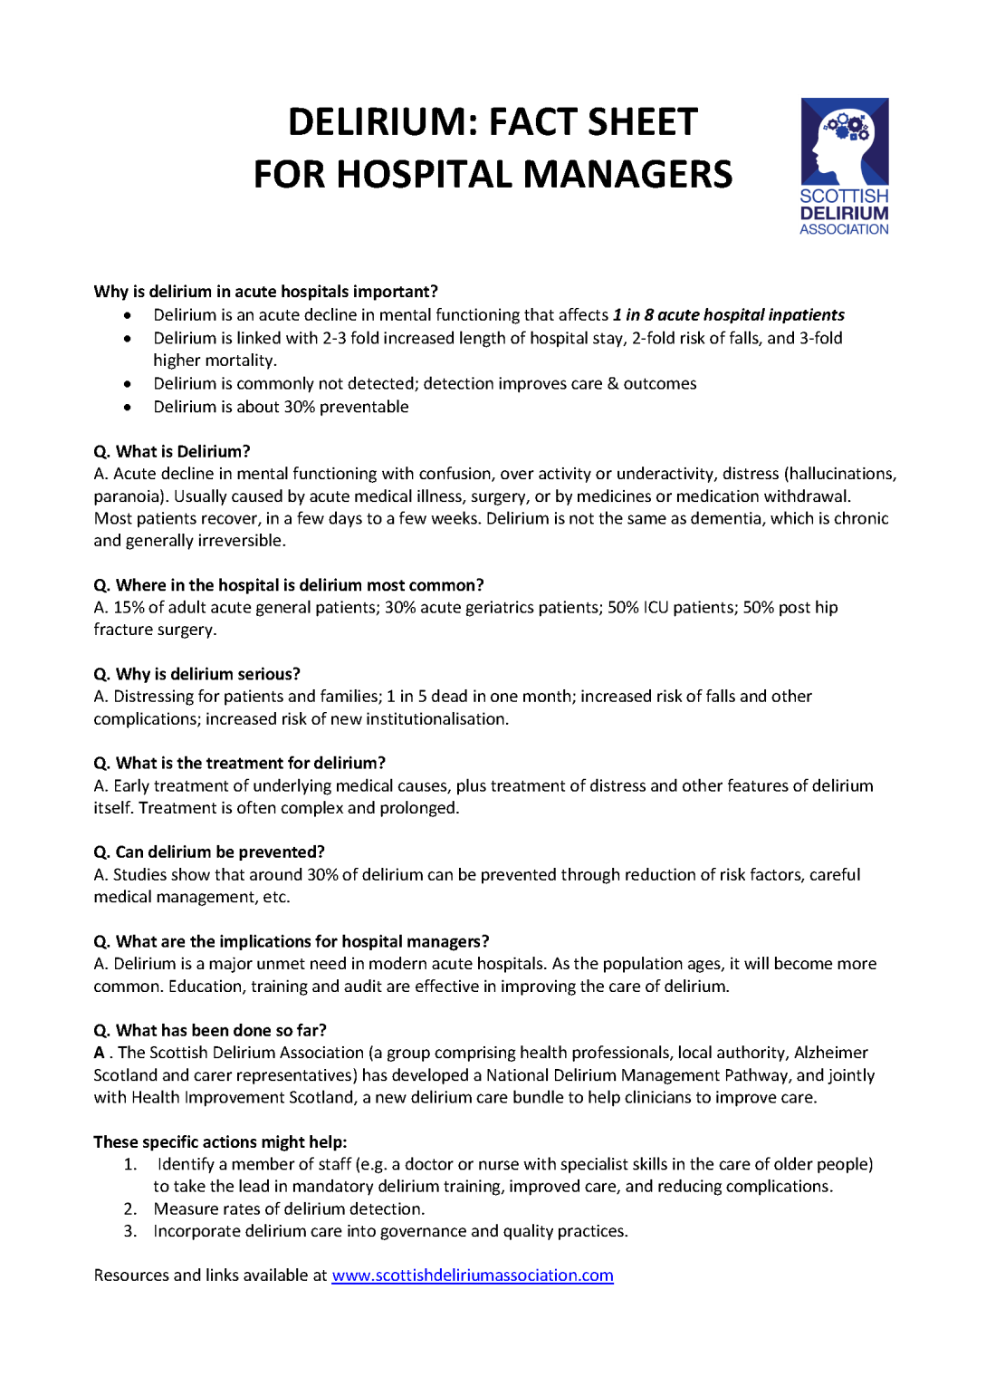

Slide 57
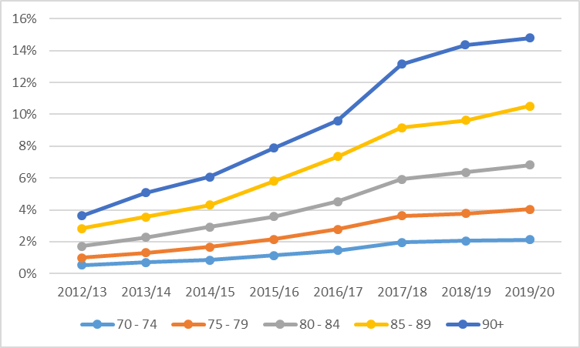
Delirium coding in NHS Scotland
Hospital administrative data (whole population) show  in delirium coding
Delirium in discharge code
Year (N~700,000/yr)
MacLullich & Jackson, unpublished. Data from Public Health Scotland (Government)

Slide 58
Conclusions and resources
Notes:
58

Slide 59
Conclusions
Delirium = a complex challenge
Good care starts with detection
Treatment involves multiple areas: causes, Rx of distress, etc.
Some delirium can be prevented
Whole system care improvements requires multiple actions
Education for all staff is at the core of improvement
Notes:
59

Slide 60
Resources
SIGN Guidelines on delirium
https://dementia-united.org.uk/delirium
www.deliriumday.com
www.the4AT.com (4AT info + general guide to delirium care)
Marie Curie website: delirium in palliative care
Notes:
60

Slide 61
World Delirium Awareness Day 2024
Wed March 13
www.deliriumday.com
Twitter – follow:
@iDelirium_Aware
Delirium societies: conferences
Australasian Delirium Association
Sydney, 1-3 November 2023
American Delirium Society
Sacramento, June 2024
European Delirium Association
The Hague, November 2024
New journals:
Delirium
Delirium Communications
World Delirium Guideline
Supported by EDA, ADS, EDA
Due 2025/2026

