Slide 1
Responding to distress in delirium
Alasdair MacLullich
Professor of Geriatric Medicine
Usher Institute, University of Edinburgh
a_maclullich Blog: www.deliriumwords.com

Slide 2
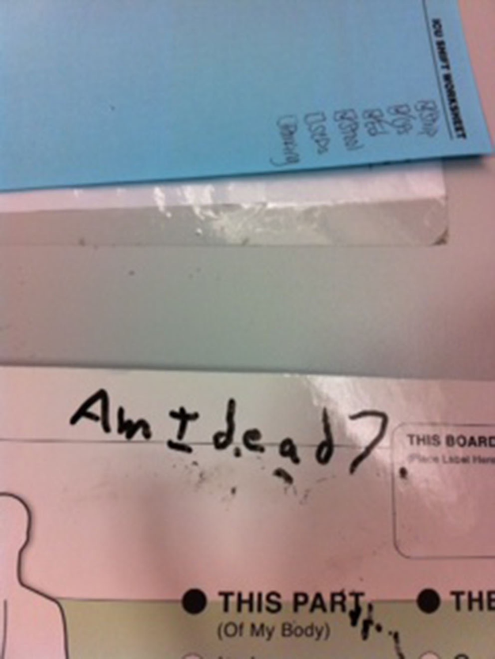
Vavuris, Intensive Care Med 2015

Slide 3
Background
Notes:
3

Slide 4
Distress: a neglected element in routine delirium care?

Slide 5
DSM-5-TR
Disturbance in attention and reduced awareness of the environment.
Acute change and tends to fluctuate throughout duration.
Additional disturbance in cognition (memory deficit, disorientation, language, visuospatial ability or perception).
Disturbances in A and C are not better explained by another pre-existing, established, or evolving neurocognitive disorder.
There is evidence that the disturbance is a direct physiological sequence of another medical condition, intoxication or withdrawal, or due to multiple etiologies.
Notes:
5

Slide 6
DSM-5-TR
Notes:
6

Slide 7
Delirium-related distress
Delirium-related distress is under-researched
Qualitative studies suggest that distress is common during delirium
After delirium, distress can persist for months or years and may be associated with long-term psychological effects
Caregivers who witness delirium also experience distress
Wilson et al, Eur Ger Med, 2020

Slide 8
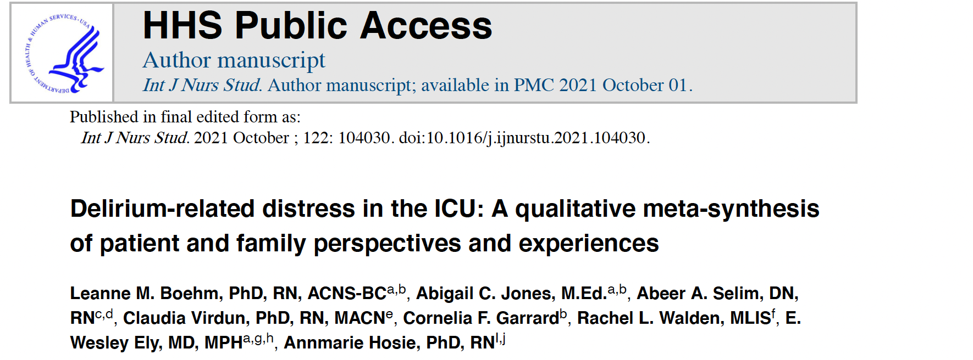

Slide 9
Aim: to better understand the nature and mediators of delirium-related distress in the ICU
Qualitative data on patient and family member delirium experiences and relieving factors (13 studies included, 294 patients and 70 family members)
164 quotes from patients
91 quotes from family members
Boehm et al., 2021

Slide 10
Theme 1 (patient experience):
ICU patient’s delirium-related distress was experienced by the whole person
Emotional, cognitive, physical, relational, and spiritual suffering
Patients felt frightened, angry, misunderstood, frustrated, overwhelmed
Predominant emotion was fear (40% of quotes)
After delirium: shame, embarrassment about their “bad” behavior
Boehm et al., 2021

Slide 11
Theme 2 (mediators):
Patients valued nurses’ presence, kindness, and explanation; and thoughts of family and home.
Words and actions that conveyed kindness and safety were appreciated
Staff conveying understanding, forgiveness, and giving explanations
Comfort, protection and guidance provided by family
Boehm et al., 2021

Slide 12
Family members’ perspectives
Theme 3 (experience):
Family members felt compassion, uncertainty, and anxiety during ICU delirium, as well as apprehension about the future
Theme 4 (mediators):
Family members valued communication with the ICU team, being involved in the patient’s care, and signs of their recovery
Boehm et al., 2021

Slide 13
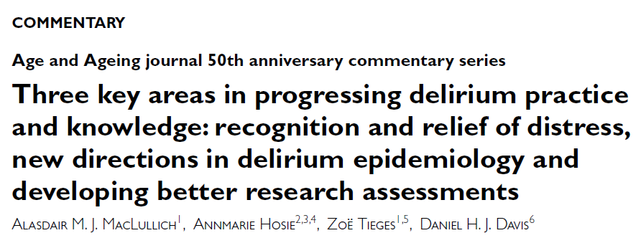

Slide 14
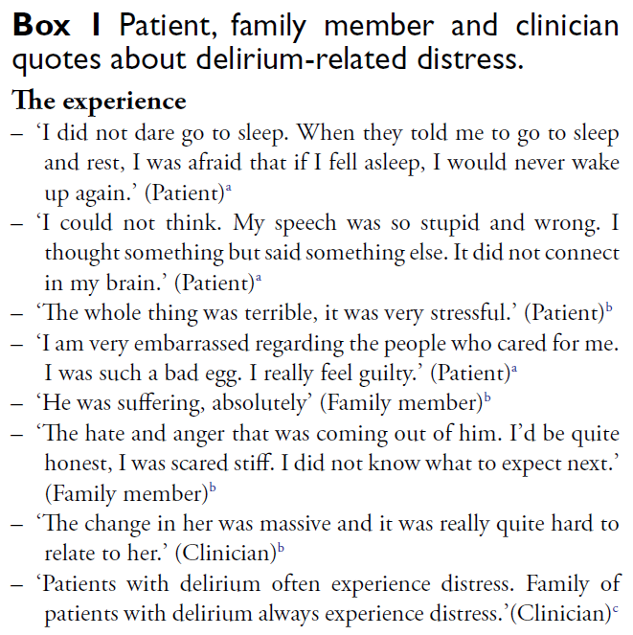
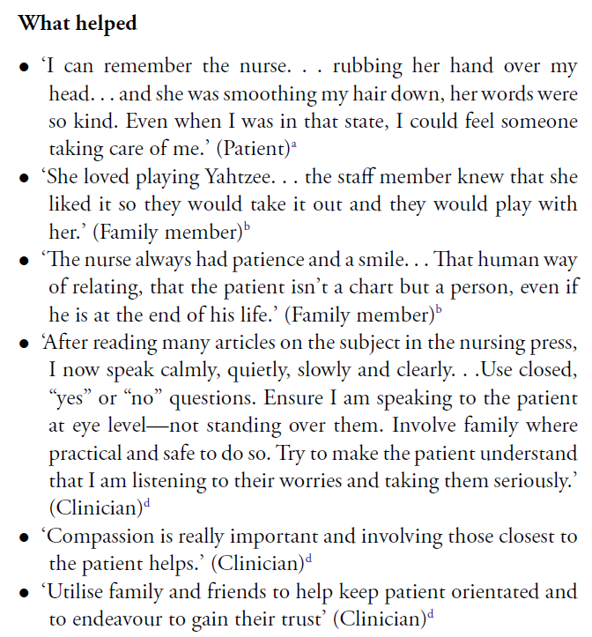

Slide 15
Mood (distress) is not routinely assessed in delirium
Evaluation of practice in N=50 older inpatients
Avram, Yusman & MacLullich, in prep
Notes:
15

Slide 16
Quick Distress Assessment Tool (QDAT)
McCartney et al, in prep
Notes:
16

Slide 17
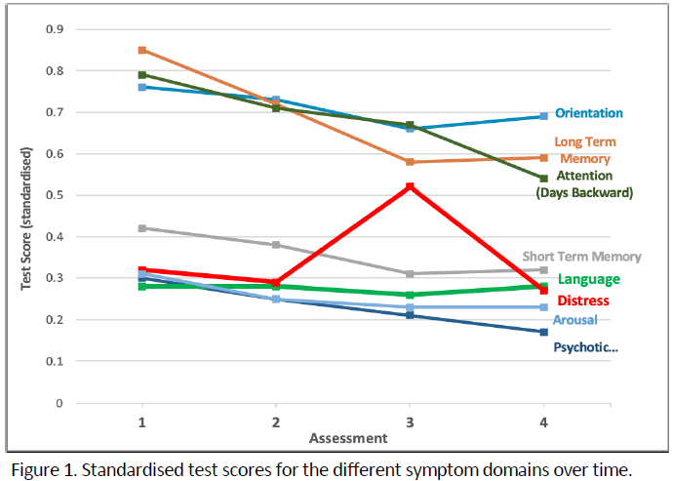
Distress in delirium is common & persistent
McCartney et al, in prep
Notes:
17

Slide 18
Distress in delirium: practice
Notes:
18

Slide 19
After Dx: assess the features of the delirium
What is this patient’s delirium like?
Cognition
Level of arousal
Distress
Delusions
Hallucinations
Etc.
Notes:
19

Slide 20
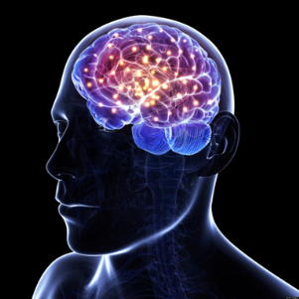
What are the potential goals of delirium treatment?
Core delirium features
Triggers
Acute cognitive change
Drowsiness, hyperarousal
Hallucinations & delusions
Other (mood, etc.)
Acute brain injury
(NB interaction with possible neurodegenerative pathology)
Acute illness
Trauma
Surgery
Drugs
Psychological stress
Longer-term outcomes
 ADLs
New institutionalization
Frailty
Acceleration of dementia
New cognitive impairment
New dementia
Post-traumatic stress symptoms
Anxiety
Depression
Loss of confidence
Patient experience
Distress
Disorientation
Etc.
Trigger-associated insults
Short-term complications
Hypotension
Hypoxia
Dehydration
Malnourishment
Inflammation
Immobility
Falls
Pneumonia
 ADLs
Mortality
LOS

Slide 21
Identify & treat causes
Optimise conditions for brain recovery
Initial check for acute, life-threatening causes
Detect & treat distress
Consider dementia
Consider follow-up
Delirium 8
Prevent complications
Rehabilitation during delirium
Communicate with patient & carers
Monitor
for recovery

Slide 22
Distress Rx as a formal element of delirium care
Find out why:
Urinary retention (very common)
Pain (very common)
Constipation
Dehydration
Fear, anxiety
Psychosis
Then address remediable causes
Also specifically treat distress:
Reassurance
Family involvement
One-to-one nursing
Drugs only if necessary …
Notes:
22

Slide 23
Speaking therapeutically to a person with delirium
Multiple accounts from people with delirium:
Wide range in the way staff speak to them
Unhelpful: silence, terse info, speaking about them with others, no introduction, doing things like taking blood without explaining
Helpful: friendly, warm, encouraging, reassuring, introducing self, providing clear explanations, explaining what is going on
“You can’t be too orientated.”
“That porter was so kind that if I won the lottery I would give him my winnings.”
Notes:
23

Slide 24
‘Therapeutic engagement’
Structured, formal approach; possible elements:
Informant Hx
Bedside observation
Initial conversation – personal introduction
Ask about how the patient is feeling
Orientation, explanation
Anchoring/reminiscence (good or neutral)
Activities (cognitive, mobilisation, etc.)
Family, other staff, etc.
Notes:
24

Slide 25
What is the role of drugs in treating distress?
No evidence of overall delirium treatment effect of drugs
No trials specifically assessing effects on distress or psychosis
If severe distress/danger - no evidence, but expert consensus:
Consider single doses or 1-2 days of risperidone, haloperidol, etc. Low doses!
Benzos 2nd line or alcohol etc., if antipsychotics contraindicated
Notes:
25

Slide 26
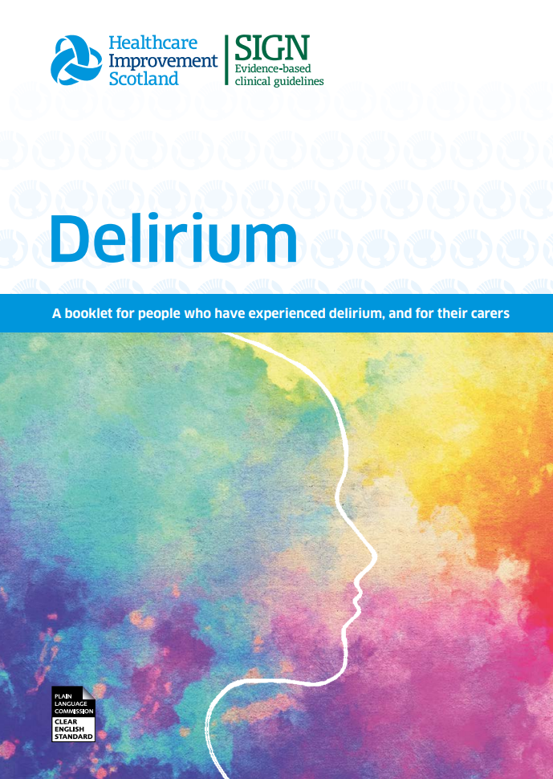
Communicate with patients & carers
Notes:
26

Slide 27
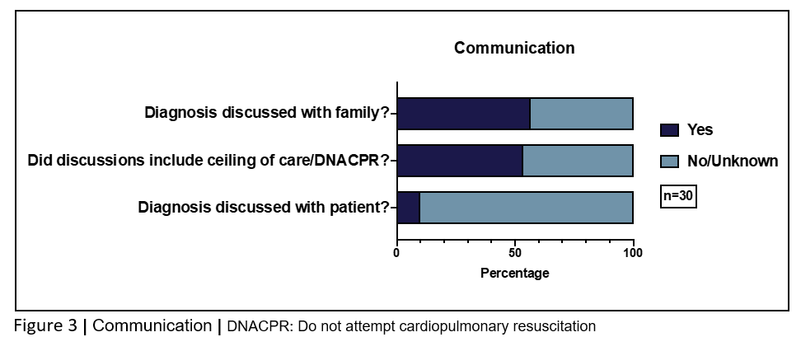
Communicate with patients & carers
Notes:
27

Slide 28
Distress in delirium: towards a new framework
Detect distress
Formal analysis of causes
Tailored interventions
Specific causes, e.g. pain
Therapeutic engagement
Family
Environment
Rehabilitation

Slide 29
Future directions
Quantify prevalence of distress during delirium
Quantify frequency of categories of causes (pain, psychosis, etc.)
Build distress detection & management into delirium care pathways
Distress assessment should include systematic survey of causes
Distress SOP / module / flowchart / algorithm
Develop ‘Therapeutic engagement’ as a formal part of delirium care
Notes:
29

Slide 30
Conclusions
Notes:
30

Slide 31
Conclusions
Delirium = a particularly difficult & complex challenge
Some research progress: epidemiology, detection, prevention
Little progress in evidence base for multidomain treatment
Real-world progress at scale remains relatively poor
But … some hope from some successful centres / UK trends in improved coding
Notes:
31

