Slide 1

The pathophysiology of delirium: a clinical perspective
Annual Congress of the German Geriatric Society, Frankfurt 2023
Alasdair MacLullich
Professor of Geriatric Medicine
Usher Institute, University of Edinburgh
Scotland
a_maclullich Blog: www.deliriumwords.com

Slide 2
Delirium =
Notes:
2

Slide 3
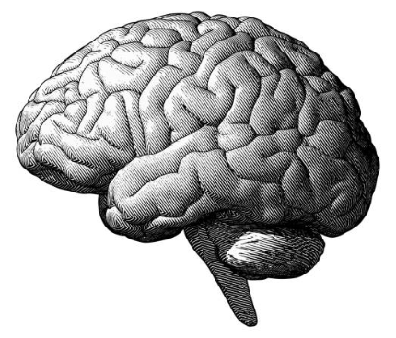
Acute brain injury
Delirium =
Notes:
3

Slide 4
“All types of weird things were going on in my head. The whole thing was terrifying. I remember speaking to Gloria on the phone to tell her that there was a bomb about to off. I was firmly convinced that this was going to happen.
It was the worst experience of my life.”
- An account of delirium
Notes:
4

Slide 5
Outline
Background information on delirium
Delirium as a risk factor for dementia
The pathophysiology of delirium
Clinical implications
Future directions

Slide 6
Background
Notes:
6

Slide 7
DSM-5-TR
Disturbance in attention and reduced awareness of the environment.
Acute change and tends to fluctuate throughout duration.
Additional disturbance in cognition (memory deficit, disorientation, language, visuospatial ability or perception).
Disturbances in A and C are not better explained by another pre-existing, established, or evolving neurocognitive disorder.
There is evidence that the disturbance is a direct physiological sequence of another medical condition, intoxication or withdrawal, or due to multiple etiologies.
Notes:
7

Slide 8
Clinical definition of delirium
Rapid (hours, days) deterioration in mental functioning, triggered by:
acute illness, injury (e.g. hip fracture), side effects of medication, surgery, etc.

Slide 9
Delirium
Acute brain failure
ICU psychosis
Pump head
Acute encephalopathy
Subacute befuddlement
Altered mental status
‘Terminological
chaos’
Septic encephalopathy
Acute confusional state
Encephalopathy
Organic brain syndrome
Metabolic encephalopathy
Acute on chronic confusion
Neurocognitive (dementia-like)
syndrome
New-onset psychosis

Slide 10
10 Societies statement - recommendations
Preferred terms
Delirium: clinical syndrome
Coma: clinical syndrome
Acute encephalopathy: pathobiological process (leading to delirium or coma)
Do not use these terms
Altered mental status
Acute confusional state
Acute brain dysfunction
Acute brain failure
Slooter et al., Intensive Care Med, 2020

Slide 11
Risk factors
Old age
Dementia
Frailty
Co-morbidities
Sensory impairment
Poor nutrition
Depression
Alcohol misuse
History of delirium

Slide 12
Delirium is a major part of the workload of healthcare systems
~15% of hospitalised patients
~30% of older ED patients
25% hip fracture patients
40-60% in ICU
~50% in palliative care settings

Slide 13


70% of delirium is present on admission
30% of delirium arises after admission
(1/3 of this can possibly be prevented)

Treatment is at least as important as prevention
Notes:
13

Slide 14
Risk of future dementia
Length of hospital stay
Post-traumatic stress symptoms
Mortality
New institutionalisation
Consequences of delirium
Dehydration
Readmission rates
Aspiration pneumonia
Pressure sores
Severe distress
Poor nutrition
Falls
Notes:
14

Slide 15
Delirium as a risk factor for dementia
Notes:
15

Slide 16
Notes:
Delirium and mortality
Delirium and dementia
All analyses show a positive relationship
Strengths
First study of delirium outcomes in general population
First models to describe trajectories of cognitive change after delirium
Able to establish pre-morbid cognition
Weaknesses
Only captures hospital admissions
Based on retrospective measure

Slide 17
Delirium is a strong risk factor for new-onset dementia
 | N |  |  | 95% CI | P
Dementia | 311 | OR | 8.7 | (2.1 to 35) | <0.01
Worse CDR | 264 | OR | 3.1 | (1.5 to 6.3) | <0.01
Mortality | 335 | HR | 1.6 | (1.3 to 2.1) | <0.01
Davis et al, Brain 2012
Notes:
NOT ADJUSTED FOR CO-MORBIDITY

Slide 18
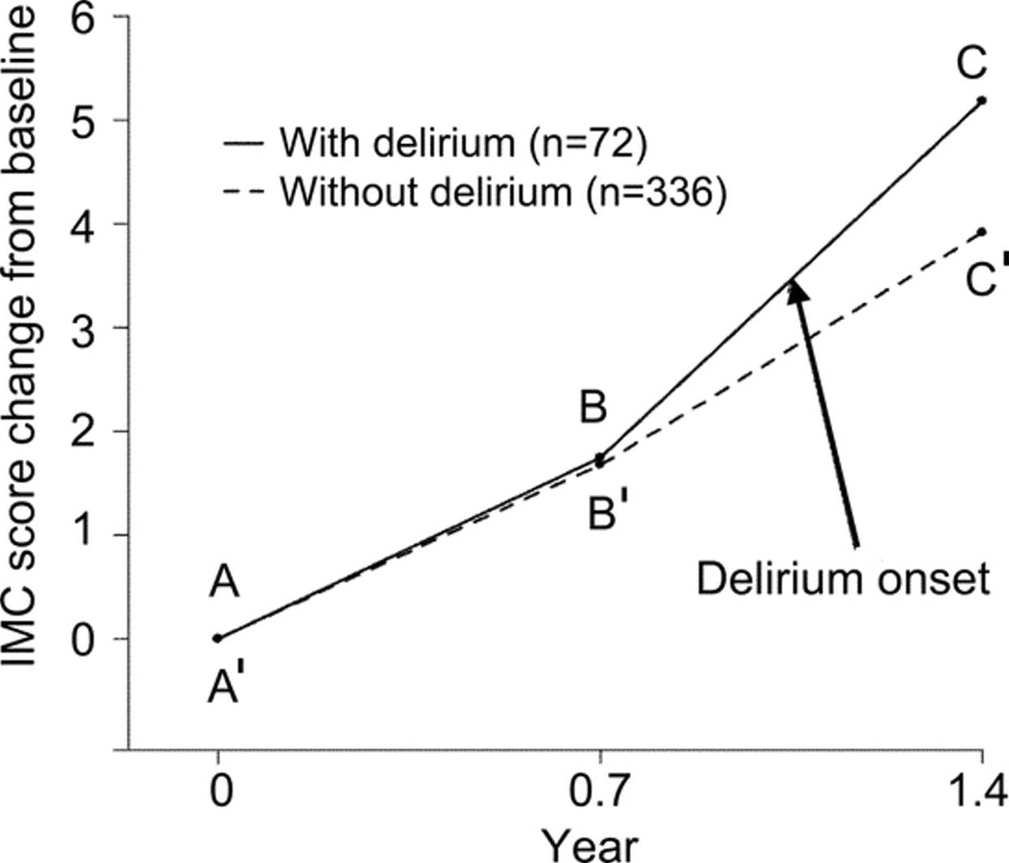
Delirium linked with memory decline in dementia
Fong, et al. Neurology 2009

Slide 19
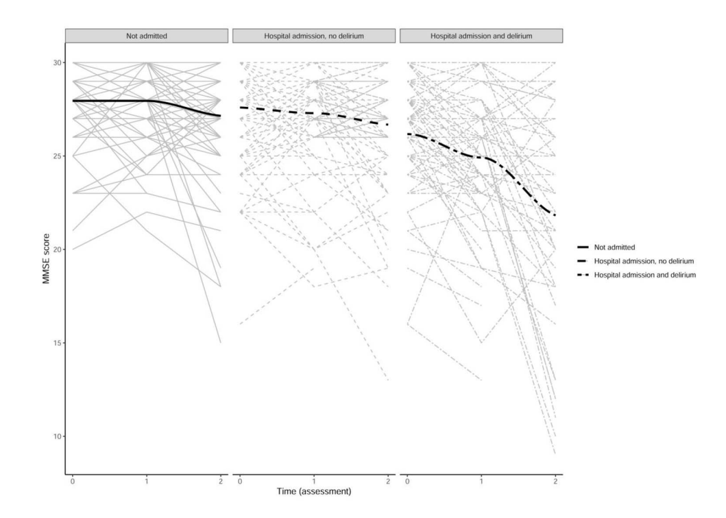
DECIDE prospective study
Hospitalisation only linked with future cognitive decline if there was delirium
‘Dose’ of delirium (severity, duration, recurrence)  higher risk of cognitive decline
Richardson, Age Ageing 2020

Slide 20
The delirium-dementia link:
key epidemiological questions
Most research has only reported simple delirium-dementia link
Little is known about the effects of:
Pre-delirium frailty, cognition, etc.
Delirium duration, severity
Delirium features (e.g. drowsiness, psychosis)
Aetiology of delirium
Notes:
20

Slide 21
The pathophysiology of delirium
Notes:
21

Slide 22
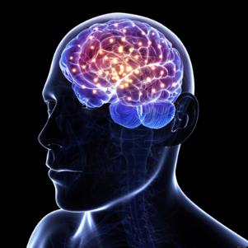
What is delirium?
Acute illness
Trauma
Surgery
Drugs
Acute cognitive change
+/-
Drowsiness, hyperarousal
+/-
Hallucinations & delusions
Acute brain injury
(Acute encephalopathy)

Slide 23
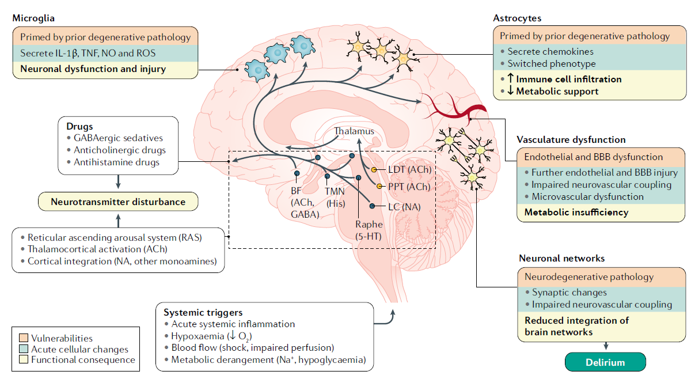
Wilson et al., Delirium. Nature Reviews Disease Primers, 2020

Slide 24
Direct brain injury
Notes:
24

Slide 25
Direct brain injury
Low oxygen
Low blood pressure
Low glucose
Physical trauma
Ischaemic lesions
Etc.

Slide 26
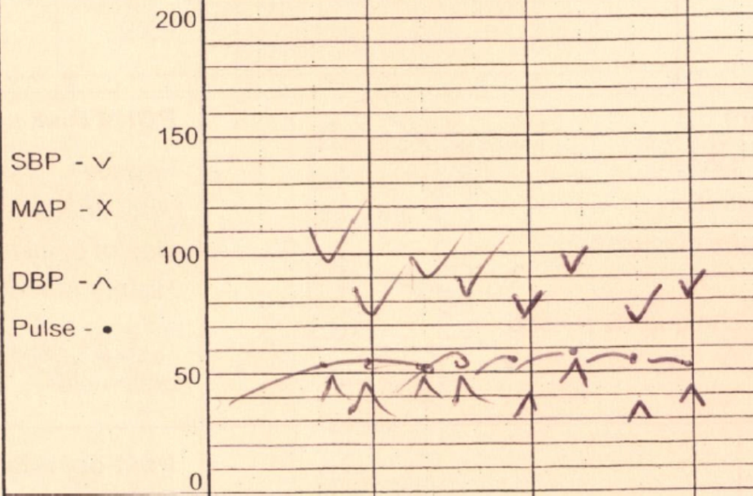
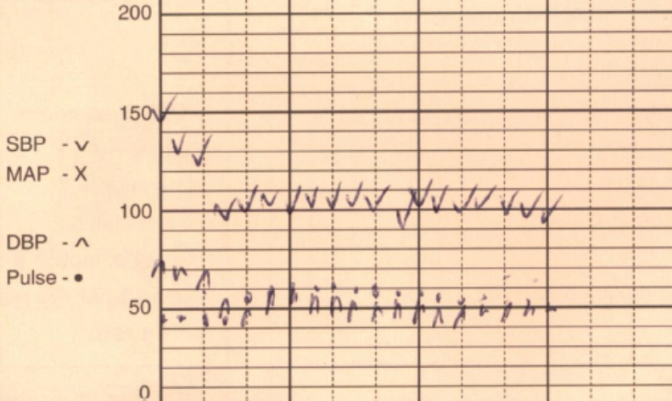
Intra-operative hypotension
Notes:
26

Slide 27
Drugs
Notes:
27

Slide 28
Drug classes commonly linked with delirium
Anticholinergics
Opioids
Benzodiazepines
Antihistamines
(Multiple others, also NB drug withdrawal effects)
Notes:
28

Slide 29
Inflammation
Notes:
29

Slide 30
Peripheral inflammation induces CNS IL-1β
Peripheral saline injection
Peripheral bacterial endotoxin injection
Cunningham et al, J Neurosci, 2005
Notes:
30
This fascinating and important experiment demonstrates that immune cells in the central nervous system are activated by PERIPHERAL inflammation; and in older diseased brains, this exaggerated response of CNS immune cells can cause neuronal dysfunction or death.

Slide 31
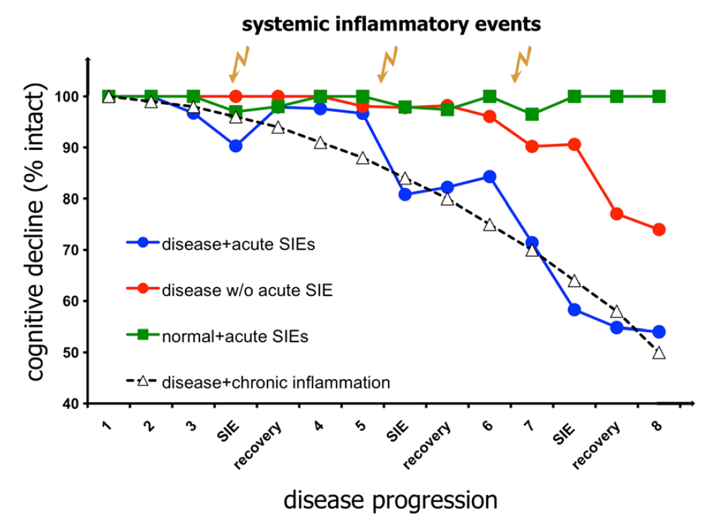
Systemic inflammation and neurodegeneration in animal models
Cunningham 2015
Notes:
31

Slide 32
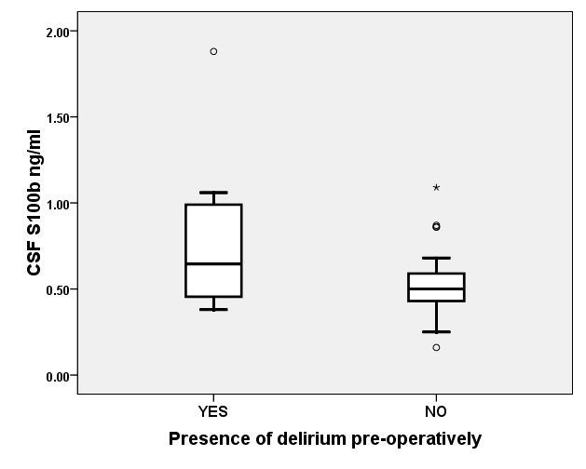
Elevated CSF S100B in delirium
p=0.011
Hall et al, 2013
Notes:
32

Slide 33
Cerebral metabolic insufficiency
Notes:
33

Slide 34
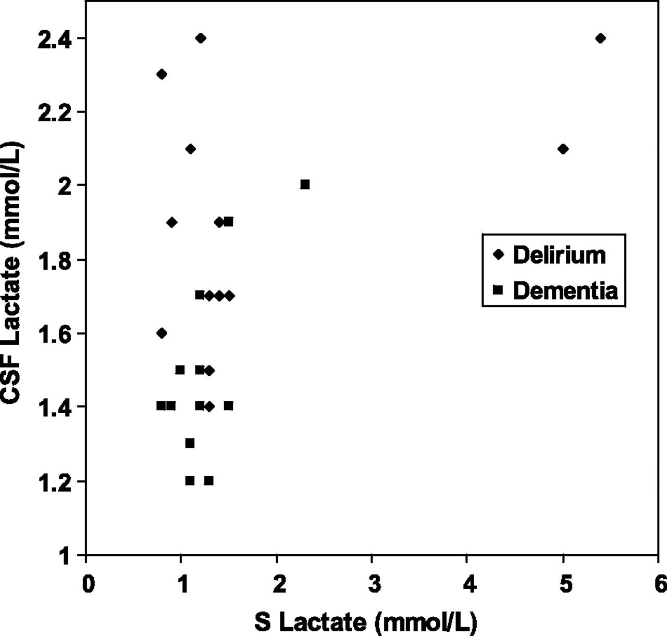
Elevated CSF lactate in delirium
p<0.001
Caplan et al., J Gerontol A Biol Sci Med Sci 2010
Notes:
34

Slide 35
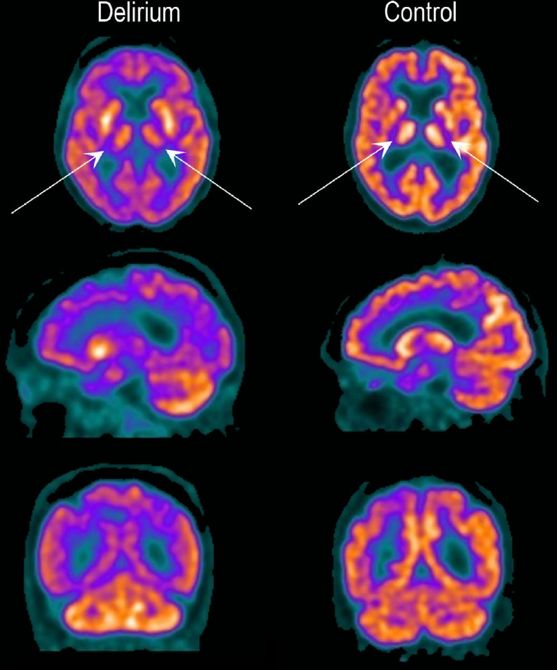
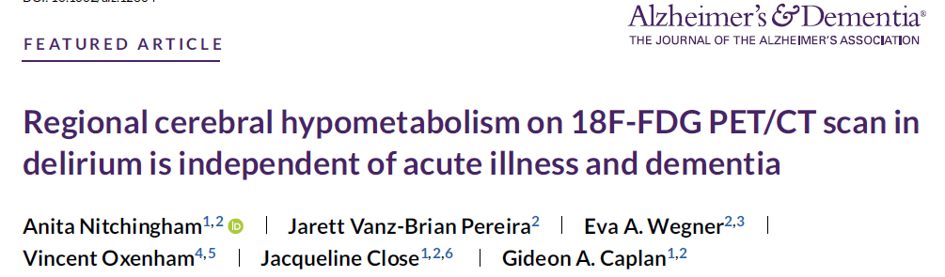
Notes:
35

Slide 36
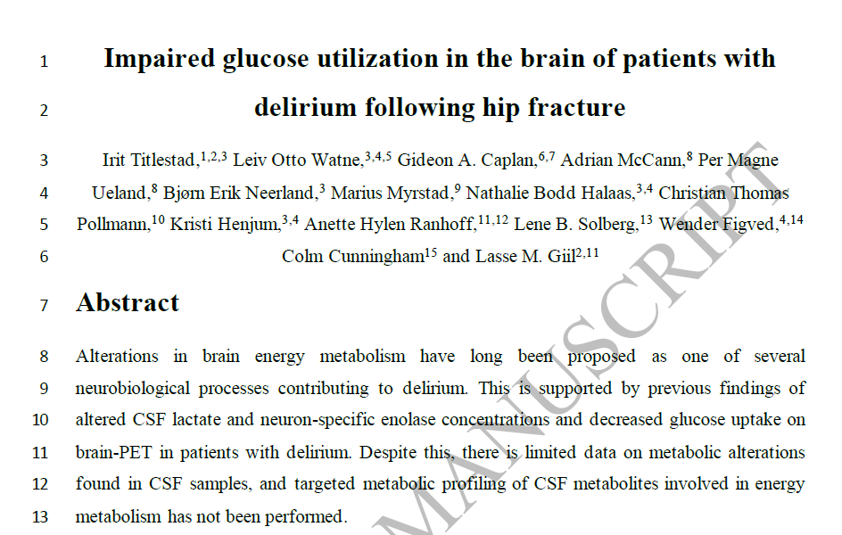
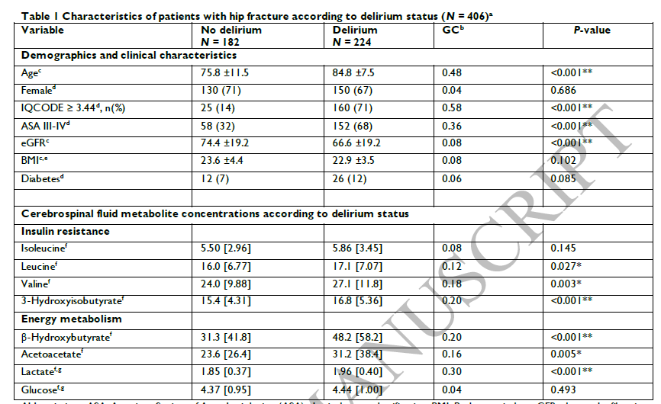
Titlestad et al., Brain 2023
Notes:
36

Slide 37
Psychological stress
Notes:
37

Slide 38
Isolation stress:  amyloid deposition in TG+ mice
Dong et al 2008
Notes:
38
38

Slide 39
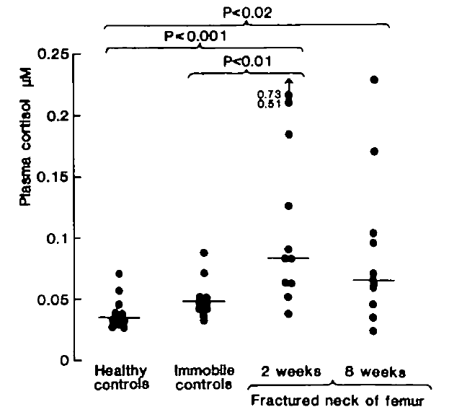
High cortisol for 8 weeks in some hip fracture patients
Roberts et al 1990

Slide 40
Delirium as a cause of brain injury
Notes:
40

Slide 41
How delirium might directly cause brain injury
    Oxygen therapy often difficult
    Hydration
    Nutrition, e.g. thiamine deficiency
Failure to take oral drugs
Risk of aspiration in drowsy patients
Stress (psychosis, isolation, threat)
Toxic effects of drugs used to ‘treat’ delirium
Notes:
41
41

Slide 42
Evidence of brain injury
Notes:
42

Slide 43
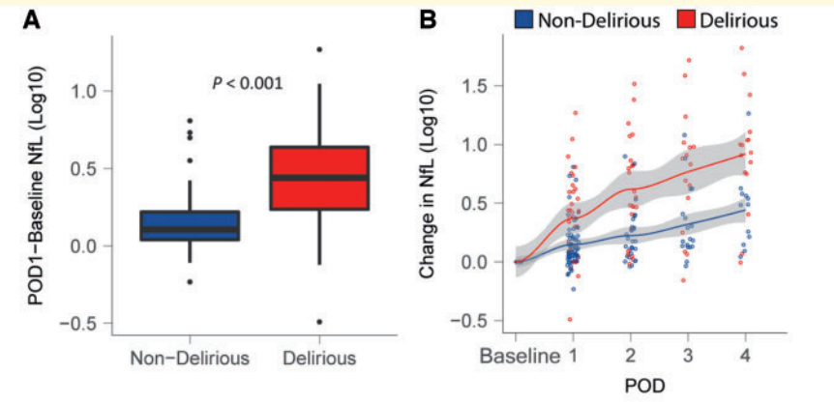
Neurofilament light higher in post-op delirium
Casey et al, Brain, 2020
Notes:
43

Slide 44
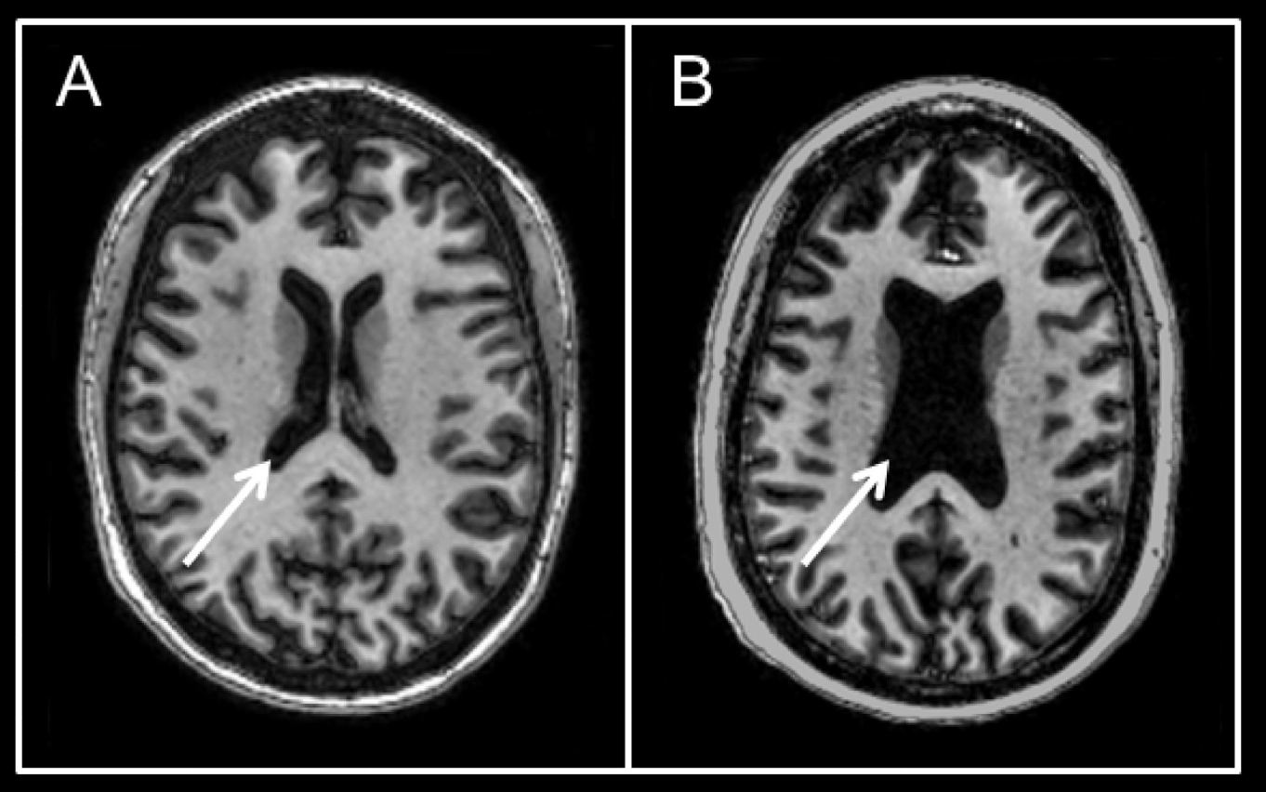
Brain atrophy associated with delirium
A: 46 year old woman with pneumonia, ARDS, no delirium
B: 42 year old woman with pneumonia, ARDS, 12 days of delirium
Gunther et al, Crit Care Med, 2012

Slide 45
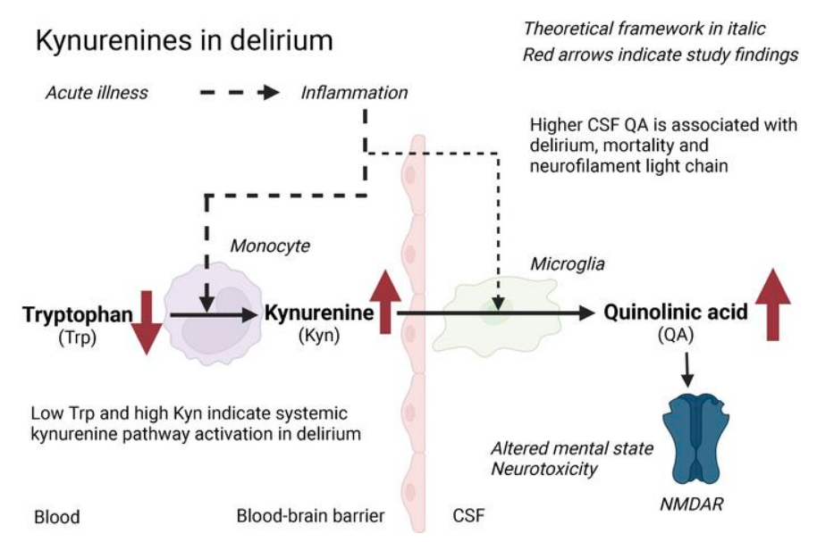
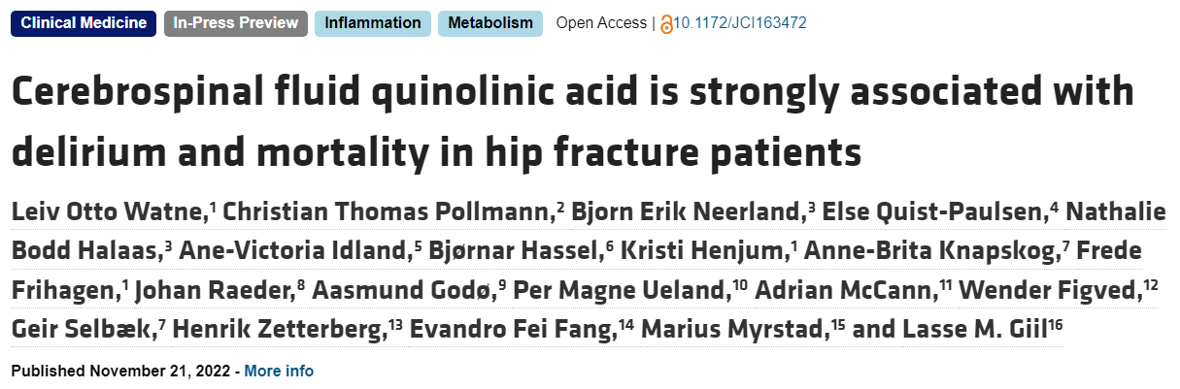
 CSF quinolinic acid in delirium
N=586 (248 with delirium)
Watne et al. J Clin Investigation 2022
Notes:
45

Slide 46
Why is delirium a risk factor for dementia?
Notes:
46

Slide 47
Proposed (competing) reasons for the delirium-dementia link
“Sign of underlying dementia – the delirium is just there because the brain is vulnerable”
“Delirium causes dementia”
“The causes of delirium damage the brain, leading to dementia ”

All are possible & all could co-exist
Notes:
47

Slide 48
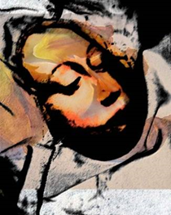
Think of an old patient in hospital with pneumonia and delirium

Slide 49
How might delirium be linked with long-term brain injury & dementia?
Hypoxia
Insulin resistance
Stress (cortisol)
Lack of stimulation
Hypotension
Inflammation
Sleep deprivation
Malnutrition
Etc.

Slide 50
Summary
Notes:
50

Slide 51
Pathophysiology of delirium: summary
Old (simple) idea: transient, benign – e.g. due to neurotransmitter disturbance
New understanding:
Multiple mechanisms
Brain is different in several possible ways during delirium
Some cases may be completely reversible (e.g. a few hrs of opioid toxicity)
But evidence of cell damage/loss in some cases
Strong link between delirium & future dementia

Slide 52
Clinical implications
Notes:
52

Slide 53
Detection
Treatment
Processes in delirium care
Prevention
Notes:
53

Slide 54
Detection
Notes:
54

Slide 55
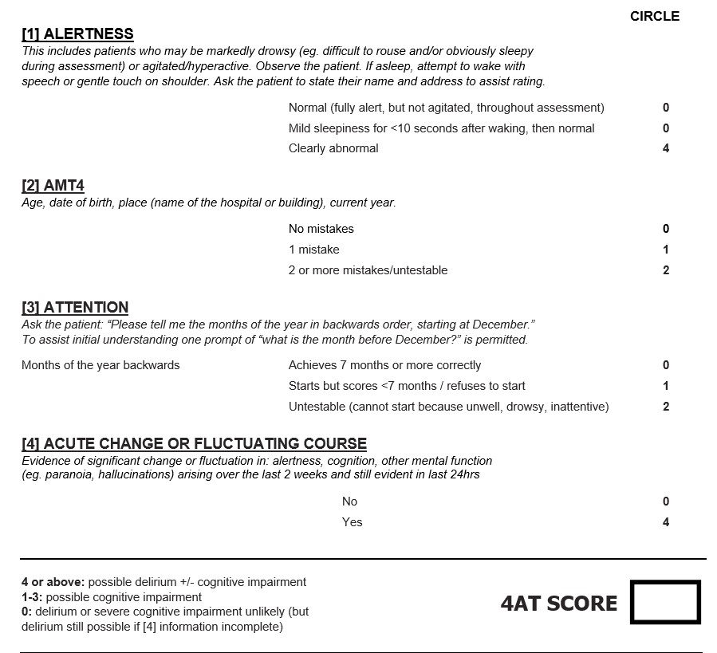
4AT (www.the4AT.com)
~2 mins
No special training needed
Some knowledge of delirium needed
Most-validated delirium tool
Used worldwide
Notes:
55

Slide 56
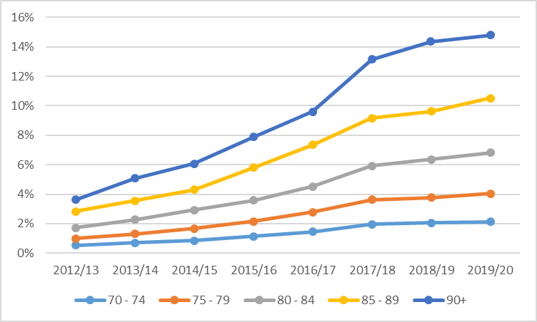
Delirium coding trends in Scotland
Hospital administrative data (whole population) show  in delirium coding
Delirium in discharge code
Year (N~700,000/yr)
Ibitoye et al, Delirium Communications, 2023

Slide 57
Treatment
Notes:
57

Slide 58
Identify & treat causes
Optimise conditions for brain recovery
Initial check for acute, life-threatening causes
Detect & treat distress
Consider dementia
Consider follow-up
Delirium 8
Prevent complications
Rehabilitation during delirium
Communicate with patient & carers
Monitor
for recovery
Adapted from SIGN Guideline on Delirium (Scotland), 2019

Slide 59
What are the potential goals of delirium treatment?
Core delirium features
Triggers
Acute cognitive change
Drowsiness, hyperarousal
Hallucinations & delusions
Other (mood, etc.)
Acute brain injury
(NB interaction with possible neurodegenerative pathology)
Acute illness
Trauma
Surgery
Drugs
Psychological stress
Longer-term outcomes
 ADLs
New institutionalisation
Frailty
Acceleration of dementia
New cognitive impairment
New dementia
Post-traumatic stress symptoms
Anxiety
Depression
Loss of confidence
Patient experience
Distress
Disorientation
Etc.
Trigger-associated insults
Short-term complications
Hypotension
Hypoxia
Dehydration
Malnourishment
Inflammation
Immobility
Falls
Pneumonia
 ADLs
Mortality
LOS

Slide 60


Slide 61
Speaking therapeutically to a person with delirium
    Multiple accounts from people with delirium:
    Wide range in the way staff speak to them
    Unhelpful: silence, terse info, speaking about them with others, no introduction, doing things like taking blood without explaining
    Helpful: friendly, warm, encouraging, reassuring, introducing self, providing clear explanations
    Patient: “You can’t be too orientated.”
    Patient: “That porter was so kind that if I won the lottery I would give him my winnings.”
Notes:
61

Slide 62
Prevention
Notes:
62

Slide 63
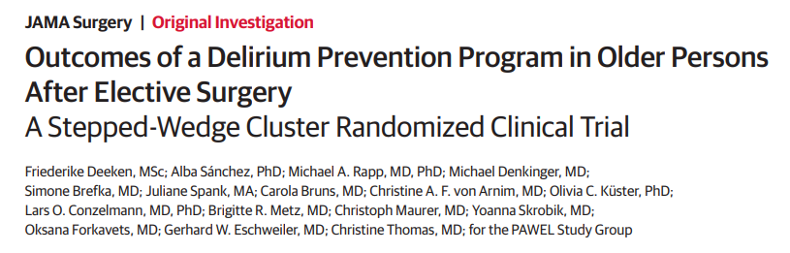
Delirium prevention studies
HELP (1999): 6 domains
Reality orientation, sleep, mobilisation, vision, hearing, hydration.
HELP (2013): 9 domains
Added (because of NICE guidelines): Hypoxia, infection, pain.
NB HELP requires volunteers: challenging to implement.
SIGN Guidelines (2019)
Orientation
Vision
Hearing
Sleep
Early mobilisation
Pain control
Postoperative complications
Hydration
Nutrition
Regulation of bladder and bowel function
Hypoxia
Medication review
Domains in other studies:
Family involvement, cognitive stimulation.
Systemic review & meta-analysis: Ludolph et al. 2020
8 RCTs; 3 HELP-based. Significant effect on risk of delirium; not on duration, falls, LOS, mortality.
NB no difference between HELP & non-HELP – i.e. volunteers not required for all prevention protocols
Deeken et al., JAMA Surg, 2021
Notes:
63

Slide 64
Does better delirium care reduce dementia risk?
Currently no evidence of this
Delirium prevention :  falls,  length of stay; no evidence of effects on dementia risk
Why no effects?
Few long-term studies
Target population inappropriate (delirium-free on admission: healthier cohorts)
Many prevention programmes e.g. HELP are limited to only some domains
Promising mechanisms in some drugs, e.g. dexmedetomidine, but no hard evidence yet
Notes:
64

Slide 65
Future directions
Notes:
65

Slide 66
Future directions
Delirium has multiple possible mechanisms
Are some of these mechanisms modifiable?
What options are available?
Prevent delirium as much as possible
Better general care during and after delirium
Drugs that treat symptoms more effectively
Drugs that target precipitating mechanisms
Drugs for neuroprotection (reducing future dementia risk)
Notes:
66

Slide 67
Strategy 1: excellent general brain care in vulnerable hospitalised patients
Delirium is a product of brain injury
Brain injury more likely with age, pre-delirium cog impairment, etc.
Multiple possible injuries (low BP, hypoxia, stress, etc.)
Need to optimise brain care to  injuries, esp in vulnerable patients
Notes:
67

Slide 68
Strategy 2: excellent acute treatment of delirium-related brain injury
Delirium can lead to further brain injury
Severe stress, nutrition, hydration, immobility, drugs used wrongly, etc.
Proactive care to reduce delirium-caused problems
Notes:
68

Slide 69
Strategy 3: rehabilitation after delirium
Delirium is linked with much worse function after acute illness
Need for multidimensional rehabilitation
Notes:
69

Slide 70
Strategy 4: new drugs to protect the brain
Multiple possible candidates:
  Anti-inflammatories
  Intranasal insulin
  Anti-glucocorticoid
Need to test drugs to prevent & treat brain injuries underlying delirium
Notes:
70

Slide 71
Conclusions
Notes:
71

Slide 72
Conclusions
    Delirium = brain injury
    Multiple mechanisms
    Best practice now: systematic approach to achieve excellent brain care
    Future practice: excellent brain care +
    New drugs targeting different elements/mechanisms
Symptoms
Neuronal loss
Inflammation
Etc.
Notes:
72
72

Slide 73
World Delirium Awareness Day 2024
Wed March 13
www.deliriumday.com
Twitter – follow:
@iDelirium_Aware
Delirium societies: conferences
Australasian Delirium Association
Sydney, 1-3 November 2023
American Delirium Society
Sacramento, June 2024
European Delirium Association
The Hague, November 2024
New journals:
Delirium
Delirium Communications
World Delirium Guideline
Supported by EDA, ADS, EDA
Due 2025/2026

