Slide 1
Equalities in delirium testing
Alasdair MacLullich
Professor of Geriatric Medicine, University of Edinburgh
Chair, Scottish Hip Fracture Audit
a_maclullich

Slide 2
Outline
Background
Diagnosis of delirium
Delirium tests used in clinical practice
Equalities issues in delirium diagnosis
Conclusions

Slide 3
Background
Notes:
3

Slide 4
DSM-5 criteria for delirium
Disturbance in attention & awareness
Acute onset, fluctuates
(Additional disturbance in cognition – always present if A is present)
Not another neurocognitive disorder; not coma
Notes:
4

Slide 5
Delirium
Acute brain failure
ICU psychosis
Pump head
Acute encephalopathy
Subacute befuddlement
Altered mental status
‘Terminological
chaos’
Septic encephalopathy
Acute confusional state
Encephalopathy
Organic brain syndrome
Metabolic encephalopathy
Acute on chronic confusion
Neurocognitive (dementia-like)
syndrome
New-onset psychosis

Slide 6
10 Societies statement - recommendations
Preferred terms
Delirium: clinical syndrome
Coma: clinical syndrome
Acute encephalopathy: pathobiological process (leading to delirium or coma)
Do not use these terms
Altered mental status
Acute confusional state
Acute brain dysfunction
Acute brain failure
Slooter et al., Intensive Care Med, 2020

Slide 7
Risk factors
Old age
Dementia
Frailty
Co-morbidities
Sensory impairment
Poor nutrition
Depression
Alcohol misuse
History of delirium

Slide 8
How common is delirium?
~15% of hospitalised patients
~20% of older ED patients
Wide range in elective surgery patients: depends on op & patient risk
Emergency surgery: 20-40% in higher risk operations

Slide 9
Duration of delirium
Most delirium lasts 3-5 days
Some resolves very quickly if one major cause that is treated promptly
Around 20% of patients have prolonged symptoms
Recovery may be partial or in some cases severe symptoms can persist

Slide 10
Risk of future dementia
Length of hospital stay
Post-traumatic stress symptoms
Mortality
New institutionalisation
Consequences of delirium
Dehydration
Readmission rates
Aspiration pneumonia
Pressure sores
Severe distress
Poor nutrition
Falls
Notes:
10

Slide 11
Diagnosis
Notes:
11

Slide 12
What is the delirium diagnostic process?
DSM-IV or DSM-5 (usually)
Presence or absence of core features:
 Attention / awareness / consciousness
 Other cognitive deficits
 Acute change / fluctuating course
Notes:
12

Slide 13
 Attention / awareness / consciousness
 Other cognitive deficits = always present if deficits in attention / awareness / consciousness
 Acute change / fluctuating course
Notes:
13

Slide 14
What is the delirium diagnostic process?
Distilled down:
 Attention / awareness / consciousness
 Acute change / fluctuating course
Notes:
14

Slide 15
“A change in the patient”

Slide 16
Delirium tests used in clinical practice
Notes:
16

Slide 17
Scenario A: ED / transitions / if delirium suspected
Eg. 86 year old man in ED with pneumonia
Arrived via ambulance (family members not present)
Question: how can you tell if this man has delirium?
Notes:
17

Slide 18
Scenario B: monitoring for new delirium in inpatients
E.g. 90 year old woman with hip# without delirium pre-op
High risk of post-op delirium
Question: how can we monitor for new-onset delirium in this lady?
Notes:
18

Slide 19
Delirium detection in practice: 2 processes
Process 1: episodic test
ED / transitions / when delirium suspected
Needs good balance of sens / spec
Needs to be close to providing diagnosis
NB diagnosis is always a clinical decision (never just a tool)
Process 2: monitoring test
Done 1-3 times/d
Needs to be sensitive
Needs to be observational
Rpt cognitive tests not suitable (practice effects, pt burden)
If positive, use (a) episodic test, or (b) clinician diagnosis
Notes:
19

Slide 20
Tools in wide clinical use
Process 1: episodic tools
4AT
CAM + variants (e.g. bCAM, 3D-CAM)
CAM-ICU & ICDSC in ICU
Process 2: monitoring tools
RADAR
SQiD
NEWS2
NuDESC
DOSS
RASS / mRASS
CAM-ICU & ICDSC in ICU
Notes:
20

Slide 21
4AT (www.the4AT.com)
3 bedside items (~1 min total)
Alertness (drowsy or hyperactive)
AMT4 (age, date of birth, place, current year)
Attention (months backwards)
1 onset item (usually <1 min)
Acute onset/fluctuation
‘a change in the patient’
Notes:
21

Slide 22
Score range 0-12
4/12 or more suggests delirium
1-3/12 suggests cognitive impairment
0 suggests no significant cognitive impairment
Notes:
22

Slide 23
Arousal & attention testing
Reduced arousal above coma = delirium (in >95% of cases)
RASS/GCS/NEWS2
Bedside attention tests:
Months backwards
Days backwards
20 down to 1
Count to 10
SAVEAHAART / CASABLANCA
Notes:
23

Slide 24
Single Question in Delirium (SQiD)
“Is your patient more confused or drowsy than normal?”
SQiD e.g. daily is useful
But main point is that rapid CHANGE in mental function often = delirium
Notes:
24

Slide 25
Equalities issues & delirium testing
Notes:
25

Slide 26
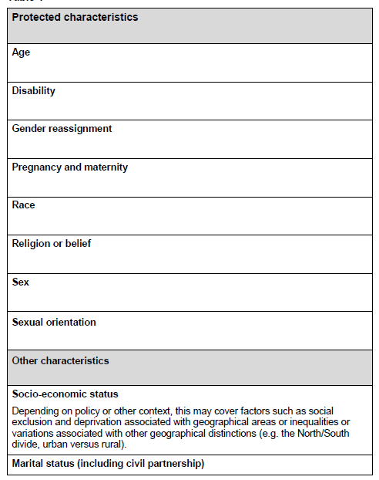
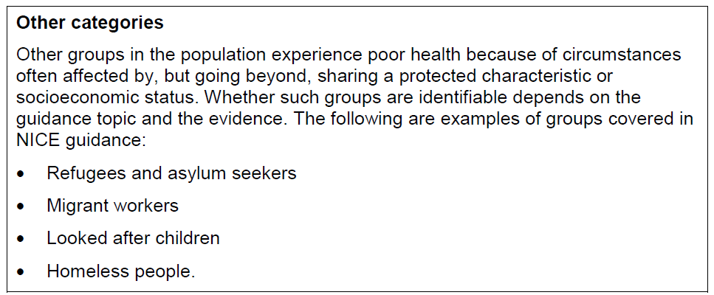
Notes:
26

Slide 27
NICE recommendations
General point: older people are at risk (poor care = equalities issue)
+ specific additional issues:
Communication & language barriers
Cultural differences
Cognitive impairment
Learning disability
Notes:
27

Slide 28
Language
Tool translations
4AT has ~20 translations
Many languages missing
Further translations underway
Some other tools, e.g. CAM also have multiple versions
At the bedside
With family member or translator if possible
If no translation possible:
Use observation: level of arousal, etc.
Info from clinical team re change/fluctuation
Notes:
28

Slide 29
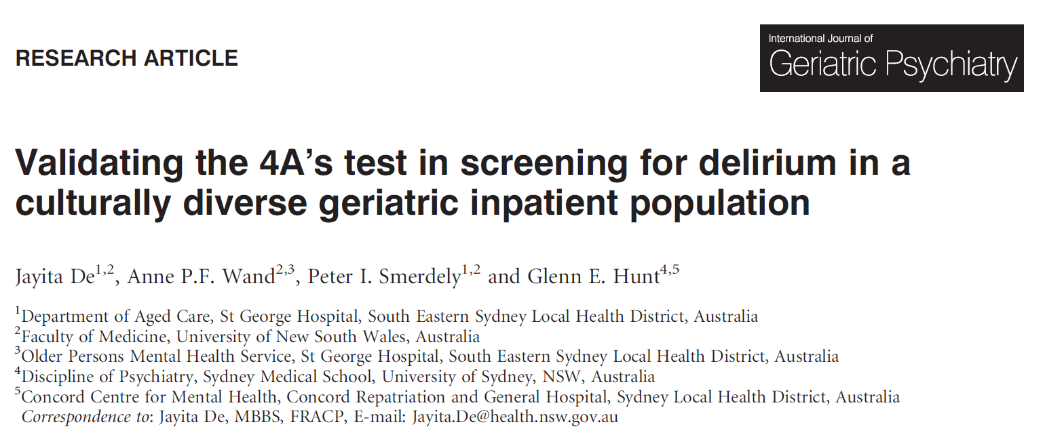
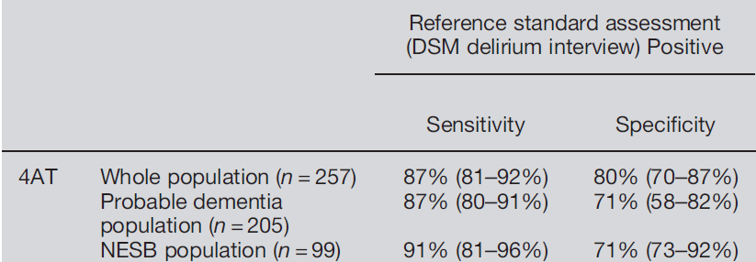
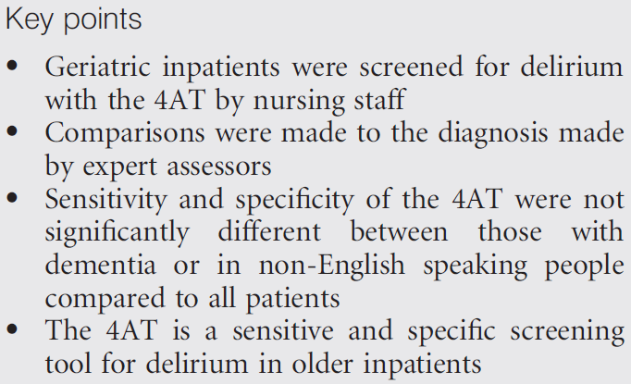
Notes:
29

Slide 30
Cultural differences
Not well-researched in delirium testing
Numeracy & literacy affect some tests
Delusions & hallucinations may relate to background
At the bedside
Key info from family is change
Not just baseline memory problems
Some might not recognise chronic impairments as abnormal
Notes:
30

Slide 31
Cognitive impairment
Dementia
Learning disability
Notes:
31

Slide 32
Delirium superimposed on dementia
In testing for dementia, level of education esp literacy & numeracy is important
Dementia present in at least 50% of delirium in older patients
Main problems:
Wide range of severity in dementia
Some patients: mild dementia with MMSE 27/30, some end-stage & non-verbal
Some end-stage patients show drowsiness & fluctuation
Dementia with Lewy Bodies: can look like delirium
Notes:
32

Slide 33
4-DSD tool
Notes:
33

Slide 34
Learning disability
Very wide range of levels of impairment
Numeracy & literacy impairments are common
Very important to get good background information
Also valuable to spend more time in pre-testing conversation
Tailor testing to patient background
Change is still the key feature to elicit
NICE recommends liaising with learning disability nurse
Notes:
34

Slide 35
Approach when patient appears non-verbal
Observe: ? Grimacing, agitation, vocalising, posture, motor abnormalities
Try 1-stage commands, e.g. ‘squeeze my hand’
Ask them to say their name
Notes:
35

Slide 36
Future research
Monitoring of tool completion rates & positive score rates in different groups
Further validation of existing tools
Development of alternative forms, e.g. attention tests
Does it work in your setting? Are there audits?
Notes:
36

Slide 37
Conclusions 1
Complex context: delirium not reliably diagnosed in general
Multiple sources of possible inaccuracy in testing
Knowledge of patient background is important
However in many cases the diagnosis is obvious, e.g. drowsiness
If unclear, evidence of other change from informant is key
Notes:
37

Slide 38
Conclusions 2
Implications for training & education
First priority is good fundamental delirium assessment skills
Then additional training on impact of other factors
Provision of delirium information in multiple languages
Notes:
38

