Slide 1



Why delirium diagnosis is so hard to do in acute and surgical wards
Prof Suzanne Timmons
Mercy University Hospital, Cork
& University College Cork, Ireland

Slide 2
Delirium is common on medical and surgical wards
Siddiqi et al (2006): Overall occurrence: 11-42%
Ryan et al (BMJ 2013): Point prevalence study, single site: 311 adult in-patients: 21% had delirium; highest in aged care wards (50%) and lowest in general surgical wards (7%)
Mossello et al (2015): Point prevalence multiple sites in Italy (n=1967): 23%
Welch et al (2019): Point prevalence multiple UK sites (n=1507): 15%.

Slide 3
Missed delirium
52% missed in an acute admissions unit (Welch et al, 2018)
56% missed in our point prevalence study (Ryan et al, 2013)
60% missed in our hip fracture study (O’Regan et al, 2012)
60% missed in people with PD (Cullinan et al, 2022)
65% missed in older in-patients (Ritter et al, 2018)
72% missed in an acute Admissions Unit (Collins et al, 2010)

Slide 4


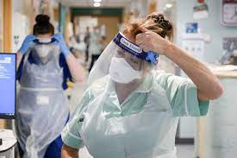
Staff/environment factors
Lack of knowledge, normalisation of indicators of delirium, inconsistent terminology
2006 survey of 784 UK trainee physicians: 21% self-reported good knowledge of diagnostic criteria for delirium; only 9% used specific screening tools for delirium. (Davis et al 2009)
2013 survey: 36% had “good knowledge” and 35% using a validated tool (Jenkin at al 2016)
2013 survey of surgical trainees: 2% knew diagnostic criteria (Shipway et al 2015)
Staff resources
Busy staff; agency staff; shift work
Staff turnover after education drives
Organisational/ Environmental issues:
Competing foci of quality improvement/metrics
Covid challenges – collateral not available, limited time with patients, masks

Slide 5
Patient factors:
Hypoactive, fluctuating
Sleep deprivation, illness
Missing glasses / hearing aids
Dysphasia, non-native language
Older person
More missed diagnoses:
Residential care and comorbidities, not acute illness severity (Collins et al, 2010)
Pain and past mental health diagnosis (Kishi et al, 2007)

Slide 6
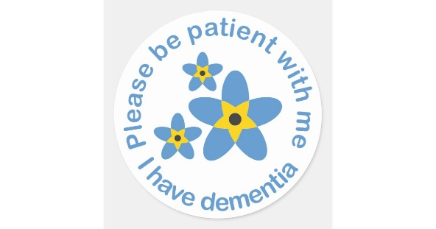
People with dementia
Challenges:
Differentiation from non-cognitive symptoms of dementia -
Hallucinations / delusions
Anxiety
Agitation / motor restlessness
Lewy body dementias- inherent fluctuations & hallucinations
Independent influences on delirium screening:
Dementia Awareness Training (aOR 14.0; 95% CI 1.6-120.4)
Dementia Pathway or Bundle (aOR 3.0; 95% CI 1.9-4.9)
Dementia was the Primary Cause of Admission (aOR=1.2; 95% CI 1.1-1.3)
900 case notes
30 hospitals

Slide 7
Delirium: stroke mimic and stroke complication
84 female, previous right hemiparesis 8 years ago, now bedbound, mute; acute left upper limb weakness and drowsiness for 2 hours– stroke or seizure or delirium?
61 male, 10 days post laparoscopic cholecystectomy; drains still in situ and on complex antibiotics; new onset nausea and agitation and facial droop- stroke or delirium?
Later, 24 hours post thrombolysis for LMCA infarct, fully resolved right hemiparesis, but now left mild hemiparesis! Bleed or delirium?
92 year old woman with moderate dementia; 16 hours post thrombolysis for left MCA stroke; now agitated, restless, catheter in situ- bleed or delirium or NCSD?
25%
Day1-5
Aphasia

Slide 8

Post-operative delirium
Occurs in 2-60%; Linked to “postoperative cognitive dysfunction”; Low detection rates.
High risk: hip fracture, cardiac surgery and neurosurgery; unplanned major surgery
Low risk surgery (e.g. elective, minimally invasive): look for other risk factors:
Age; dementia, previous delirium; alcohol abuse; electrolyte abnormality

Slide 9
So what can we do?
Risk stratify
Screen all

Slide 10
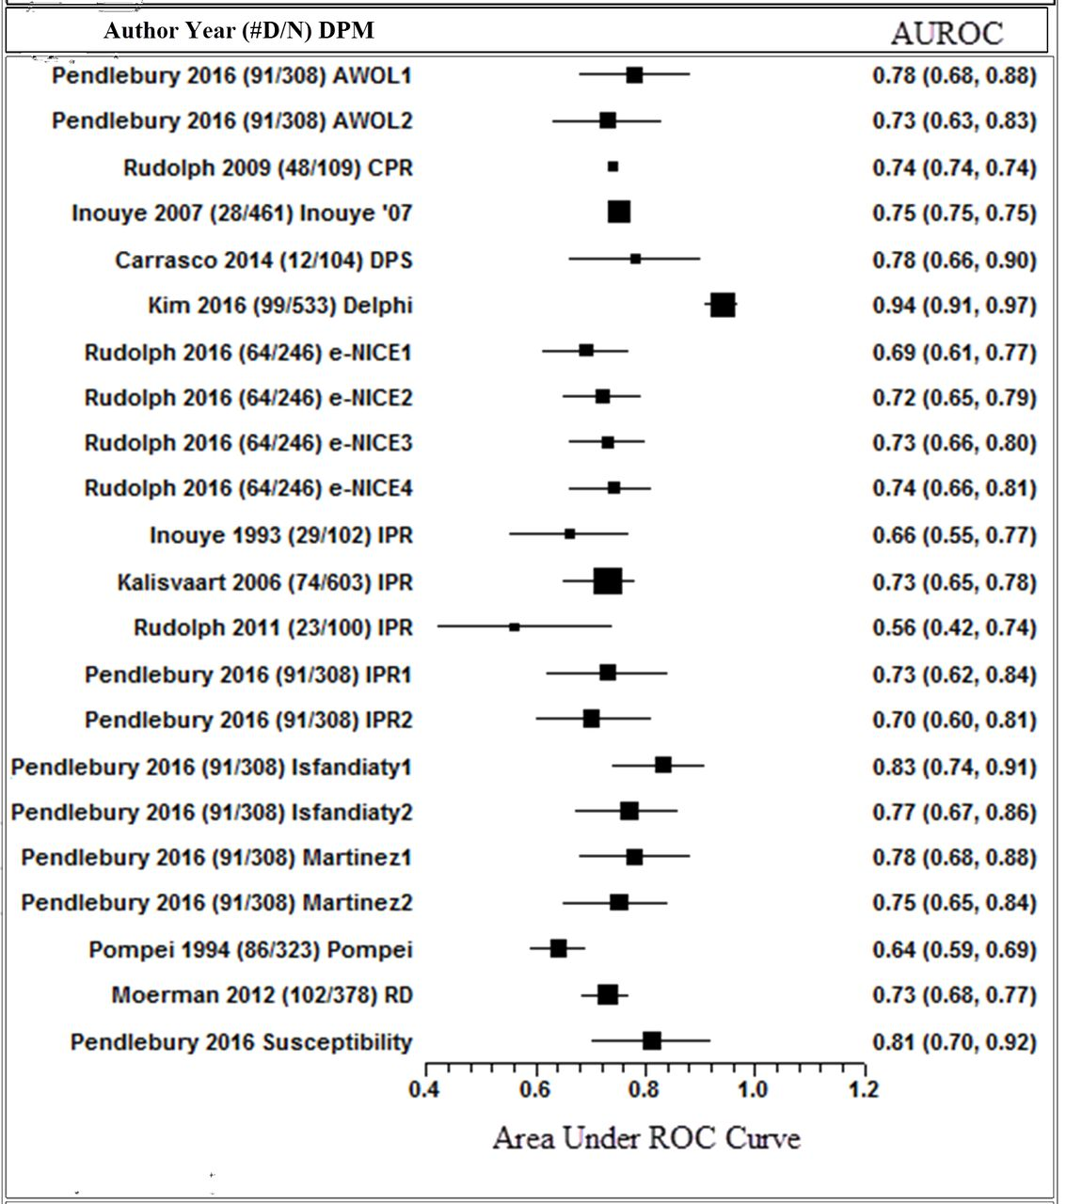
Delirium prediction tools
From Lindroth et al 2019

Slide 11
Who is at greatest risk of delirium post stroke?
Author/ year/ no. | Age | Previous Delirium | Cog Imp | Drug/ alcohol | Severity | Location | Size | Aphasia | Neglect | Vision | CRP | WCC
2014 Oldenbeuving; 1000 |  |  |  |  |  |  MCA |  |  |  |  |  | 
2017 Alvarez-Perez; 1161 |  |  | Dem |  | Haem | Ant, cort |  |  |  |  |  | 
2017 Lim; 576 |  |  |  |  Cigs | 
2018 Pasinska; 750 |  |  |  |  |  |  |  |  |  |  |  | 
2019 Shaw 2019; 400 |  |  |  |  | 
2020 Nakamiso; 400 |  |  | Dem |  |  |  |  |  |  | 
2022 Rhee; 8000 images |  |  |  |  | Haem | Ant, cort

Slide 12
Screening tools
Ultrabrief tests: if low risk – eg MOTYB (O’Regan et al 2014); Days of the Week Backwards (Marra et al, 2018); SSF (Meagher 2010),
or use SQiD (Sands et al, 2010)
Brief tests: e.g. 4AT https://www.the4at.com/
Incorporate screening into a routine task: e.g. RADAR Voyer et al, 2015

Slide 13
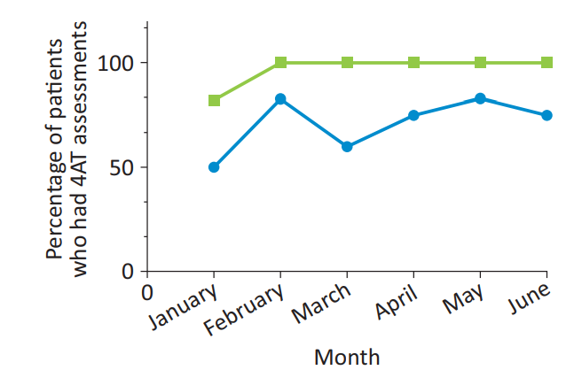
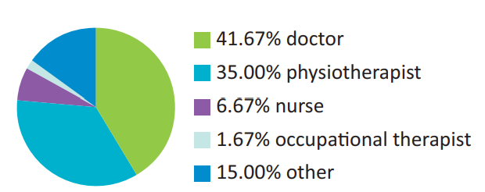
Can we improve screening on wards?
QI project on 2 Acute Medical Units in London (junior doctor & nurse awareness sessions, 4AT training); 40% screening → 61% screening at 1-4 month post intervention period Bauernfreund et al 2018
QI project in aged care ward in NI (staff education/awareness, then delirium pathway → 99% post intervention at risk were screened (CAM); delirium diagnosis rates increased from 5.7% to 35% Tauro 2014
QI project in two surgical wards in London (awareness raising, staff education: SQiD→4AT embedded electronically) → 4AT completed at least once in 71% → 97% Dormandy et al 2019
QI project in aged care ward in US (staff nurse education, electronic health record integration of NuDESC [nurses selected it], regular evaluation and feedback): 0% delirium documented → 99% had at least one NuDESC assessment, but the 8 positive cases were missed. Solberg 2012

Slide 14
Can we improve screening on wards?
QI project on 2 Acute Medical Units in London (junior doctor & nurse awareness sessions, 4AT training); 40% screening → 61% screening at 1-4 month post intervention period Bauernfreund et al 2018
QI project in aged care ward in NI (staff education/awareness, then delirium pathway → 99% post intervention at risk were screened (CAM); delirium diagnosis rates increased from 5.7% to 35% Tauro 2014
QI project in two surgical wards in London (awareness raising, staff education: SQiD→4AT embedded electronically) → 4AT completed at least once in 71% → 97% Dormandy et al 2019
QI project in aged care ward in US (staff nurse education, electronic health record integration of NuDESC [nurses selected it], regular evaluation and feedback): 0% delirium documented → 99% had at least one NuDESC assessment, but the 8 positive cases were missed. Solberg 2012
QI project in 6 stroke units in 5 hospitals (NuDESC screening 3 times within 24 hours – 30 mins training session, pocket cards, posters, videos) → 90% compliance Nydahl et al 2022
QI project in acute surgical unit (SQiD: awareness raising [poster, card] → embed in paperwork): 15%→20%→50% use McCleary et al 2015

Slide 15
Making it easier for staff ←→ normalisation
Top down: delirium as priority at health service and hospital group level
Make delirium training mandatory with targets
Embed delirium screening in all relevant pathways- eg falls, dementia, frailty, using common assessment tools and linked actions if screening positive

Slide 16
Making it easier for staff

Slide 17
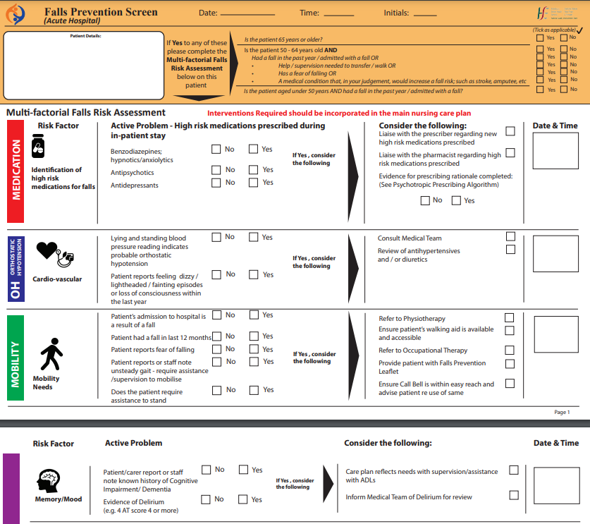
Making it easier for staff

Slide 18

Take home points
Staff awareness raising and training in the use of screening tools is key;
but this has to be linked to prevention, and management actions…
and it has to be ongoing….
and supported at organisational level.

