Slide 1
Delirium detection in hip fracture care
Alasdair MacLullich
Professor of Geriatric Medicine, University of Edinburgh
Chair, Scottish Hip Fracture Audit
a_maclullich

Slide 2
Mrs PT, an 85 year old lady, is living at home independently. She has some concerns about her memory but generally manages with day to day activities.
Unfortunately Mrs PT has a fall at home and finds that she can’t get up. She calls an ambulance. In the hospital an X-ray shows a broken hip.
Her son comes to visit that evening and finds her to be very confused, which is different from her normal self. She is upset and agitated, and can’t concentrate on a normal conversation.
Mrs PT does not believe that she has a broken hip, and she keeps trying to get out of bed so that she can return home. She tells her son that she has been wrongfully arrested and has been locked up in a police station. Mrs PT asks her son to help her escape.
The son and the staff note that Mrs PT is frightened and distressed.
Notes:
Delirium is very common, and it is likely that most of the audience have come across it – certainly those working in healthcare, and also I think many people have witnessed or even experienced delirium in their personal lives.
To help illustrate this I have summarised a real cases from my own practice here in this hospital
The first involves a lady …

Slide 3
Background
Notes:
3

Slide 4
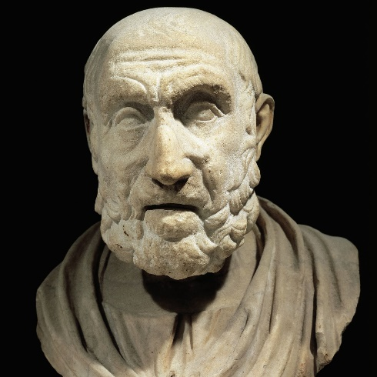
A brief history of delirium 1
Documented in ancient medical texts (e.g. Hippocrates)
Term “delirium” used in 1st century by Celsus
(Latin: de-lira, to go out of the furrow)
16th – 18th centuries: various names; linked with fever & bad prognosis
E.g. Barrough: mostly deadly, & linked with loss of memory in survivors
19th century: ongoing problems with multiple names

Slide 5
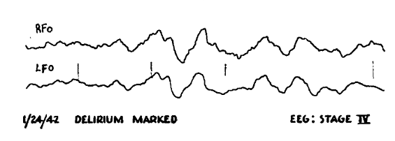
A brief history of delirium 2
20th century: early – “confusion” vs “delirium” in some accounts
Description of diagnostic features, e.g. altered consciousness
Research: Engel & Ramona 1944– EEG in delirium
DSM initially used “acute confusional state”; changed to “delirium” in 1980

Slide 6
Engel & Romano, 1959
“Not only does the presence of delirium often complicate and render more difficult the treatment of a serious illness, but also it carries the serious possibility of permanent irreversible brain damage.”
“The physician who is greatly concerned to protect the functional integrity of the heart, liver, and kidneys … has not yet learned to have similar regard for the functional integrity of the brain.”

Slide 7
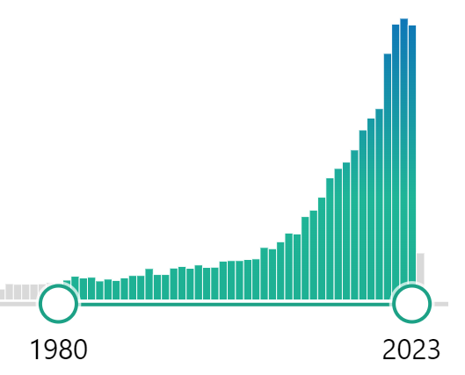
A brief history of delirium 3
Research output  1980s onwards,  from 2005
85 papers in 1980  2168 in 2023
Detection tools from ~1980s
Delirium prevention studies 1990s
European Delirium Association 2006
NICE guidelines 2010
Research papers on delirium
(Pubmed)

Slide 8
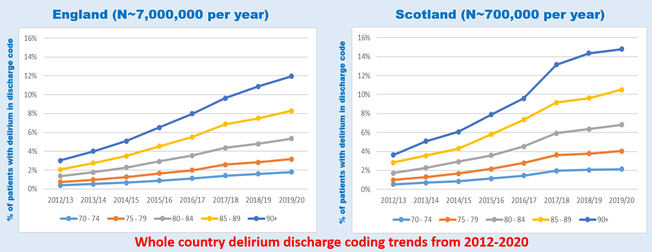
Growth in detection rates: UK

Slide 9
What is delirium?
Notes:
9

Slide 10
Working definition of delirium
Rapid (hours, days) deterioration in mental functioning, triggered by:
acute illness, injury (e.g. hip fracture), side effects of medication, surgery, etc.

Slide 11
“A change in the patient”

Slide 12
How common is delirium in hip fracture?
~20% on admission
~25-50% post-op (depending on study)
Older studies = higher rates
Likely that better care has reduced rates in some systems to ~25-30%

Slide 13
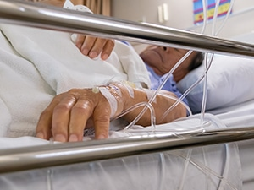
When does delirium present in hip # pts?
Injury
Hospital admission
ED attendance
Operation
Post-operative ward care
70%
+30%

Slide 14
What are the background risk factors for delirium?
Older age
Dementia
Frailty
Sensory impairment
Chronic illness
Previous episodes of delirium

Slide 15
Risk of future dementia
Length of hospital stay
Post-traumatic stress symptoms
Mortality
New institutionalisation
Consequences of delirium
Dehydration
Readmission rates
Aspiration pneumonia
Pressure sores
Severe distress
Poor mobility recovery
Falls
Notes:
15

Slide 16
How long does delirium last?
The median duration is 3-5 days
Wide range of durations: some resolves very quickly
Around 20% of patients have prolonged symptoms
Recovery may be partial or in some cases severe symptoms can persist

Slide 17
Delirium versus dementia
Notes:
17

Slide 18
Delirium versus dementia
Delirium
Rapid onset (hours, days)
Inattention (hard to focus)
Often resolves in few days
Fluctuates more than dementia
Drowsiness / hyperactivity common
New paranoia & hallucinations in ~30%
Dementia
Slow onset (months, years)
Many do not have significant inattention
Mostly irreversible
Drowsiness uncommon (late stages only)
Notes:
18

Slide 19
Why detect delirium?
Notes:
19

Slide 20
Reflection
Consider a patient with delirium.
What differences in care would there be with and without detection?

Slide 21
10 reasons to detect delirium www.deliriumwords.com
Can be presenting feature of life-threatening illness
Ongoing rehabilitation - modified
Prompts assessment for delirium-associated risks such as falls, immobility, dehydration
Prompts search for acute triggers
Access to standard delirium treatment pathways
Communicate the diagnosis to patients and carers
May be a sign of undiagnosed dementia
Prognostic information
To identify & treat distress
Accurate coding: important in future care

Slide 22
Consequences of missed delirium
More distress in patients & carers
More distress in staff
Longer length of stay
Higher risk of falls
Longer duration & severity of delirium (NB  workload)
Slower rehabilitation
Worse pain management
Medicolegal risk:  in cases involving missed delirium

Slide 23
How can we detect delirium?
Notes:
23

Slide 24
How can delirium present?
Persistent sleepiness
Strange new ideas, e.g. being poisoned
Hyperactivity
Mixed-up speech
Hallucinations
Altered sleep-wake cycle
Irritability/marked change in mood
Lethargic/quiet/saying little

Slide 25
2 main processes for delirium detection
[A] Proactive assessment for delirium at points of high risk
At presentation (ED), on admission to ward, post-op (at least once, preferably POD1)
[B] Regular monitoring for delirium in inpatients
‘Think Delirium’ – be vigilant for drowsiness, distress, or any signs of change in behaviour
Some use tools like the Single Question in Delirium (SQiD)
If any suspicion, do a 4AT
Notes:
25

Slide 26
Assessment at points of high risk
Presentation
Ward admission
POD1 (+/- POD2,3)
4AT
Inpatient monitoring
NO
E.g. after POD3
MONITOR daily for signs of delirium
Signs of delirium?
4AT
YES
Notes:
26

Slide 27
www.the4AT.com
Notes:
27

Slide 28
Score range 0-12
0/12  no significant cognitive impairment
1-3/12  cognitive impairment
4/12 or more  delirium
Notes:
28

Slide 29
Alertness
AMT4
Attention
4AT
Acute change / fluctuation

Slide 30
Item 1: Alertness
Notes:
30

Slide 31
Item 2: AMT4
Notes:
31

Slide 32
Item 3: Months Backward
Notes:
32

Slide 33
All patients can be scored with the 4AT
No ‘unable to assess’ (UTA) results
Notes:
33

Slide 34
Item 4: Acute change or fluctuating course
Sources of info:
You
Family
Casenotes
GP letter
The patient
Example questions to patients:
“Are you concerned about anything going on here?”
“Do you feel frightened by anything or anyone?”
“Have you been seeing or hearing anything unusual?”
Notes:
34

Slide 35
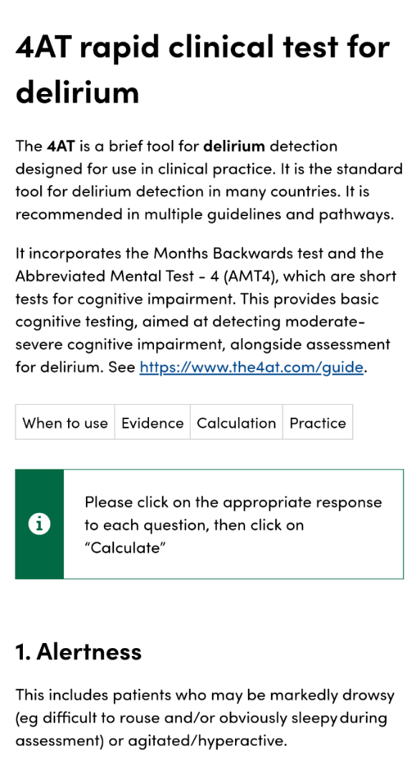
New 4AT app
Standalone app (like CFS app)
Free, no registration
Android + iOS
Search “4AT delirium”

Slide 36
Single Question in Delirium (SQiD)
“Is your patient more confused or drowsy than normal?”
SQiD e.g. daily is useful
But main point is that rapid CHANGE in mental function often = delirium
Notes:
36

Slide 37
How can we assess for recovery?
Notes:
37

Slide 38
Delirium recovery: practice points
First step is detection, using the word ‘delirium’
Then include plan for reassessments
Monitor specific features, e.g.
‘patient still drowsy’ / ‘patient now more awake’
‘patient still distressed & hallucinating’ / ‘less distressed. Denies hallucinations’
Document resolution or persistence in transfers of care
4AT provides a useful tool to assist in tracking recovery

Slide 39
Treatment
Notes:
39

Slide 40
Identify & treat causes
Optimise conditions for brain recovery
Initial check for acute, life-threatening causes
Detect & treat distress
Consider dementia
Consider follow-up
Delirium 8
Prevent complications
Rehabilitation during delirium
Communicate with patient & carers
Monitor
for recovery

Slide 41
Common causes of delirium in hip fracture
Fracture, operation
Infection (UTI, chest, skin, wound, etc.)
Dehydration / acute kidney injury
Constipation
Anaemia
Drug changes (starting or stopping)
Injuries
Psychological stress (isolation, immobility, uncertainty)
? Intraop factors (depth of anaesthesia, hypotension)

Slide 42
Detect & treat distress
Find out why:
Pain (very common)
Urinary retention (very common)
Constipation
Dehydration
Fear, anxiety
Psychosis
Then address remediable causes
Also specifically treat distress:
Reassurance
Family involvement
One-to-one nursing
Drugs only if necessary
Notes:
42

Slide 43
Speaking therapeutically to a person with delirium
Multiple accounts from people with delirium:
Wide range in the way staff speak to them
Unhelpful: silence, no info, speaking about them with others, no introduction, doing things like taking blood without explaining
Helpful: friendly, warm, encouraging, reassuring, introducing self, providing clear explanations, explaining what is going on
“You can’t be too orientated.”
“That porter was so kind that if I won the lottery I would give him my winnings.”
Notes:
43

Slide 44
What is the role of drugs in delirium treatment?
No evidence of overall delirium treatment effect, so …
No prescription just for delirium diagnosis
If severe distress/danger - no evidence, but expert consensus:
Consider single doses or 1-2 days of risperidone, haloperidol, etc. Low doses!
Benzos 2nd line or alcohol etc., if antipsychotics contraindicated
Notes:
44

Slide 45
Conclusions and resources
Notes:
45

Slide 46
Conclusions
Delirium = a complex challenge
Good care starts with detection
4AT on admission (pre-op) & post-op will detect most delirium
Be vigilant re delirium arising later in the patient stay
Treatment involves multiple areas: causes, Rx of distress, etc.
Notes:
46

Slide 47
World Delirium Awareness Day 2024
Wed March 13
www.deliriumday.com
Twitter – follow:
@iDelirium_Aware
Delirium societies: conferences
American Delirium Society
Sacramento, June 2024
European Delirium Association
The Hague, November 2024
Australasian Delirium Association
Cairns, July 2025
Fragility Fracture Network
Istanbul
10-12 October 2024
https://fragilityfracturenetwork.org/
World Delirium Guideline
Supported by EDA, ADS, EDA
Due 2025/2026

